Slide 1




Green Transition and Skills Development in the GCC
Leveraging Intra-Regional Mobility with Circular Migration

Slide 2
Policy Issue: Skills gaps could slow green growth in the GCC
GCC economies are accelerating green investments across energy, infrastructure, and industry.
Demand for green skills is rising faster than existing labour supply mechanisms can fill.
Skills shortages risk becoming a binding constraint on green growth and diversification.
Coordinated regional action can convert labour mobility into a strategic advantage.

Slide 3
Research Objectives
Map the key green economy sectors and related green skills needs in the GCC.
Assess current migration frameworks in the GCC.
Review and draw applicable lessons from the EU’s skills-based migration schemes.
Propose design principles, potential implementation milestones, and financing options for a GCC-wide ‘Green Talent Pool’.

Slide 4
The GCC’s green transition is in full swing
Most GCC states have committed to net-zero targets (2050 or 2060); all seek to increase renewables’ share in energy mix.
Large sums committed to renewables, hydrogen, CCUS, sustainable infrastructure, and more.
Renewable energy capacity grew from near zero in 2013 to over 5 GW by 2022.
Hydrogen exports could generate up to USD 130 billion annually by 2050.

Slide 5
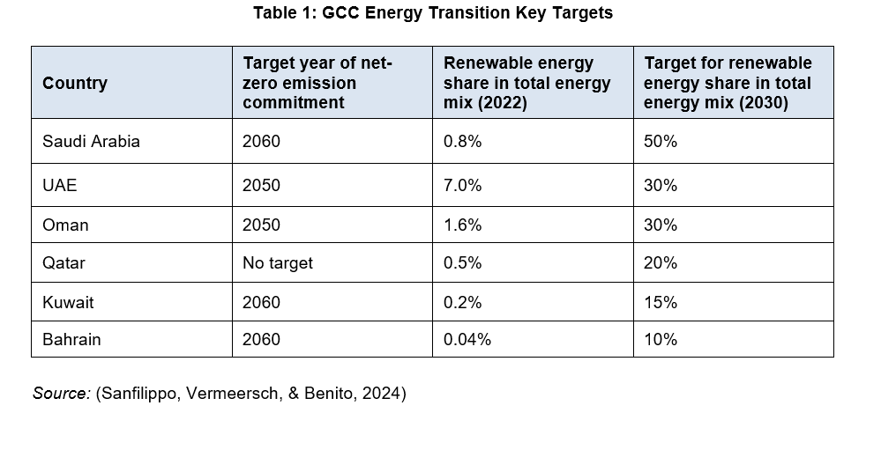

Slide 6
Key green sectors
Renewable Energy (solar, wind, nuclear)
Carbon Management & Hydrogen
Sustainable Tourism & Hospitality
Sustainable Construction & infrastructure
Manufacturing (EVs, solar panels, low-carbon materials)
Waste Management
Controlled-Environment Agriculture
ICT

Slide 7
GCC green labour demand is outstripping supply
Estimated 1 million green jobs in the GCC by 2030; higher under optimistic decarbonisation scenarios.
Demand spans high-skilled roles like engineers & project managers to medium-to-low-skilled ones such as technicians, installers, and plant operators.
TVET systems adapting slowly to new green occupational standards.
University pipelines face time lags for specialised skills.
Rapid project rollout outpaces training capacity.
SMEs likely to face the sharpest skills constraints.

Slide 8
Circular labour migration is a core GCC strength
~30 million foreign nationals reside in the GCC; ~52% of the total population.
The region hosts ~10% of the world’s international migrants.
Circular, contract-based migration has underpinned growth in the GCC since the 1970s.
Existing circularity can be leveraged for green skills development.

Slide 9
Fragmented migration systems limit regional skills allocation
Migration governance and visa rules remain largely nationally segmented.
Workers admitted to one GCC state cannot easily move to another.
Thus, skills are generally locked into single-country labour markets.
Fragmentation raises costs and reduces flexibility for employers.

Slide 10
Regional coordination can unlock labour market efficiency
Green projects are unevenly distributed across GCC countries.
Labour demand can fluctuate across sectors and timelines.
Regional pooling can enable faster and more accurate matching of skills to projects.
It can also lower recruitment costs for employers.
All of this can increase the GCC’s overall economic productivity through a more efficient labour market.

Slide 11
The EU shows the value of linking skills, job matching, and intra-regional mobility
Faces similar green and digital skills shortages
Developed an intra-regional, skills-based migration architecture
Combines three elements:
EU Talent Partnerships with migrant origin countries such as Morocco, Tunisia, Egypt, Nigeria, Senegal, Bangladesh, and Pakistan.
Intra-regional mobility for skilled workers via the EU Blue Card.
Digital talent matching through the EU Talent Pool.

Slide 12
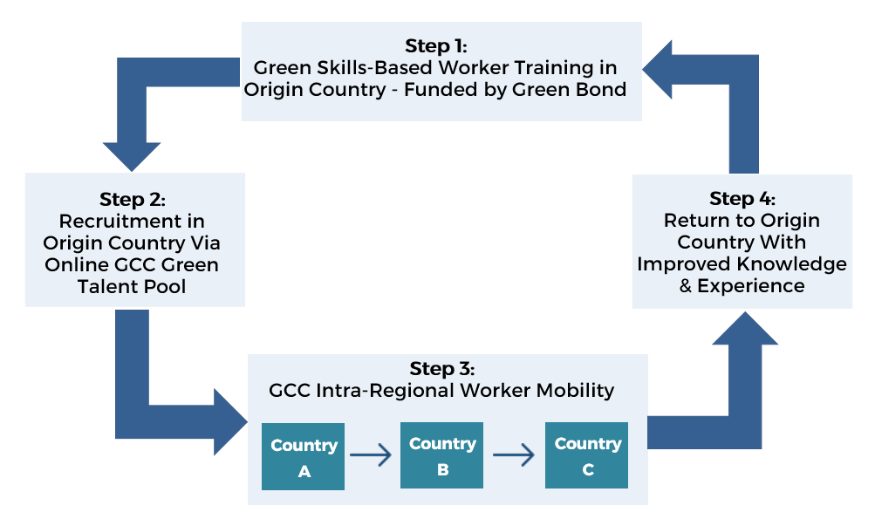
A vision for GCC’s own Green Talent Pool

Slide 13
Key principles
Limited intra-GCC mobility for selected green skills and occupations, building on existing circular migration patterns.
Complementing, not replacing, existing national migration systems.
A tiered system of visa durations and mobility rights differentiated by skill level.
Alignment of certification and skills recognition frameworks across GCC states.
Skills development in origin countries through bilateral or multilateral partnerships.
Explicit preservation of circularity to support development outcomes in origin countries.
Involvement of governments, employers, training institutions, and international organizations in governance.

Slide 14
A phased roadmap allows progress without over-commitment
Concept formulation and technical discussions among GCC states.
Political buy-in and in-principle agreement at leadership level.
Detailed design of governance, visas, skills scope, and training models.
Initial pilot launch with selected origin countries and sectors
Full implementation and phased regional scaling

Slide 15
Green bonds can finance skills as strategic infrastructure
GCC green bond and sukuk markets are expanding rapidly.
A green bond can fund training and certification in origin countries, co-finance public-private employment partnerships in the GCC, and support digital and institutional infrastructure for fair and efficient recruitment.
It can aligns investor ESG objectives with economic and workforce development objectives, both in the GCC and migrant origin countries.
Requires innovative structuring, strong governance, and robust impact reporting.

Slide 16
A last word: early collective action by the GCC can secure long-term competitiveness
Green skills availability is a strategic need.
Existing migration patterns can be upgraded, not reinvented.
A GCC Green Talent Pool offers a pragmatic and phased policy solution.

