Slide 1


The Promise of Global Skill Partnerships and the Need to Invest in Skills and International Worker Mobility Systems Presenter:
Jeremy Lebow Economist, Social Policy, WBG

Slide 2
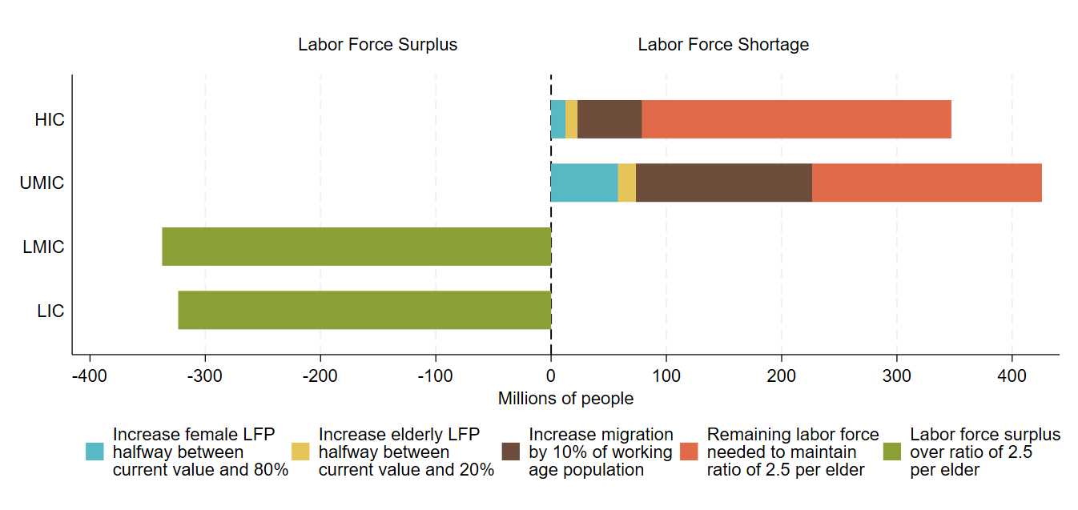
The demographic dividend presents a great challenge, but also a great opportunity for L/MICs
Labor force (millions) needed to maintain 2.5 workers per elder (65+) by 2050
By 2050, HICs/UMICs will need to grow their labor force by over 700 million
A combination of policies will be needed
Meanwhile, LICs/LMICs can lose up to 600 million before facing labor shortages, but they lack needed education & skills
Source: Authors’ calculations based on the UN Population Division median variant projections (no migration scenario) and labor force participation rates from ILO

Slide 3
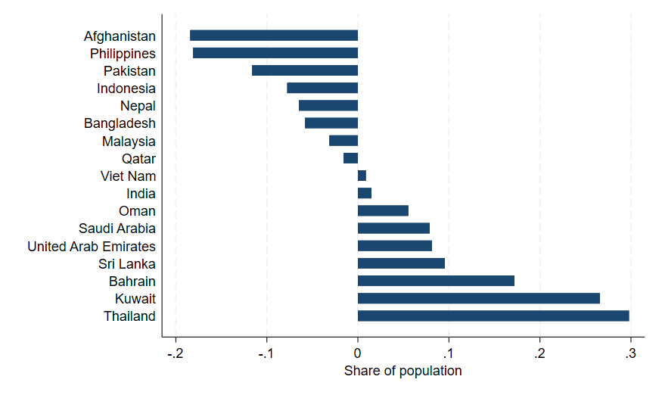
The demographic imbalance is strong across Abu Dhabi Dialogue member countries
Labor force (millions) needed to maintain 2.5 workers per elder (65+) by 2050
Large surpluses in traditional origin countries on scale of 15-25 million (46 million in Pakistan)
India, Vietnam, and Sri Lanka have aging on the horizon, with below-replacement fertility
Large and persistent need for workers in Thailand and GCC countries
Source: Authors’ calculations based on the UN Population Division median variant projections (no migration scenario) and labor force participation rates from ILO

Slide 4








Shortages are especially prevalent in mid-skill occupations across many sectors
Manufacturing
Mechanics & Technicians
Construction
Healthcare & Elderly Care
Hospitality & Services
Renewable Energy
ICT
Source: CEDEFOP 2023; World Economic Forum 2025

Slide 5
What are the benefits of skilled and semi-skilled emigration for origin countries?
Poverty reduction and remittances
Knowledge and investment
Migration is more effective than any known anti-poverty program with typical income gains of 200-600%, especially for higher-skill (Clemens 2013)
Migration opportunities increase incentive to study
For every nurse graduates that receives a US visa, 9 more license to work domestically
Bangladesh-Malaysia visa lottery winners experienced a 3x wage increase, more than doubling their household income
Source: Abarcar & Theoharides (2024)
Skilled migration increases business networks, investment, & trade with advanced economies
Source: Mobarak et al. (2023)
US exports to Vietnam increased in states with large Vietnamese populations
Remittances increase human development, household resilience, and eventually growth
Source: Parsons & Vézina (2018)
Globally, ~40% of skilled migrants return within 10 years with high productivity & entrepreneurship
Filipino provinces which (randomly) receive more remittances have better education, domestic wages, and productivity 2 decades later
Yugoslavian return-migrants from Germany boosted industry output & exports
Source: Khanna et al. (2022)
Source: Bahar et al. (2024), Amanzadeh et al. (2024)
Notes:
diaspora often accounts for a large share of FDI flows

Slide 6
Risks and policy responses: Vulnerabilities preventing migrants from reaching their full potential
Policy: Strengthen worker mobility systems
Challenge #1: Vulnerabilities at each stage of the migration cycle
Ensure access to information ➔ reduced exploitation, smarter migration, and increased productivity (Shrestha & Yang 2019)
Provide a decent and timely visa process
Support integration with proper language training, skill recognition, and job matching (Foged et al. 2024; Batista et al. 2024)
Increase legal pathways and coordination through bilateral agreements
Lack of information & unethical recruitment
Undocumented or dangerous pathways
Poor integration or under-employment in destination
Poor re-integration or social isolation after return
Lack of social protection
Filipino Department of Migrant Workers supports job search, skills upgrading, pre-departure training, legal aid, consular services, and reintegration
Source: Ang & Tiongson (2023)

Slide 7
Risks and policy responses: Turning “Brain Drain” into “Brain Gain and Circulation”
Challenge #2: Brain drain (when loss of human capital outweighs benefit)
Policy responses
1) Invest in education and training for critical sectors (including GSPs) to increase the total worker supply
2) Diaspora engagement including supporting remittances, investment, knowledge exchange, and return migration
3) Link both to domestic industrial development strategies (example on next slide)
Brain drain is most concerning when:
Lack of skilled workers/graduates at home
Low knowledge transfer & investment from diaspora
Limited return migration
Often driven by lack of quality work or professional development opportunities at home
Malaysia’s TalentCorp initiative provided tax benefits and other incentives for return ➔ 10% increase in return, net fiscal gain
Efforts to ban or restrict emigration outright usually increase undocumented migration, which can be dangerous, unproductive, and reduce development gains
Source: World Bank (2015)
Notes:
E.g. knowledge exchange, trade, and investment via marketplaces, business networking platforms, matching grants, etc

Slide 8
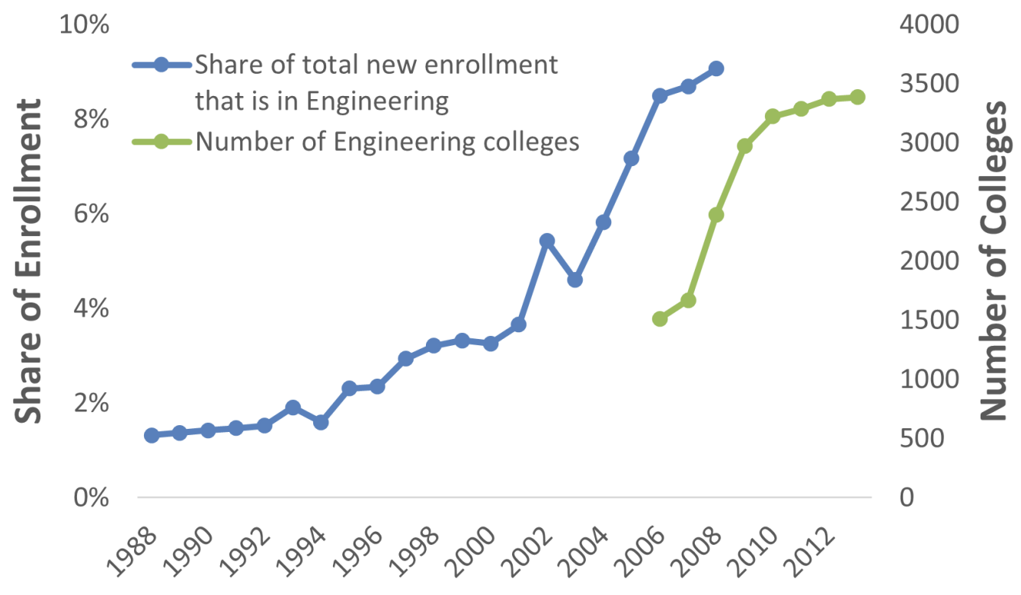
India’s IT Boom: A success story of migration, human capital, and growth
In the late 1990s, US skilled visa caps increased, and Indian enrollment in IT degrees surged:
What happened as a result?
Most graduates remained and contributed to India’s “IT Boom”
Strong diaspora networks transferred knowledge, investment, & stimulated offshoring back home, ~25% returned
What key ingredient converted “brain drain” into “brain gain”?
US visa cap increases
Source: Khanna and Morales (2023)
Notes:
MOST CAN’T MIGRATE – U.S. visa caps and transitions to permanency are limited
Brain Drain converted into Brain Gain – words used by Prime Minister Manmohan Singh, 2010

Slide 9
India’s IT Boom: A success story of migration, human capital, and growth
In the late 1990s, US skilled visa caps increased, and Indian enrollment in IT degrees surged:
What happened as a result?
Most graduates remained and contributed to India’s “IT Boom”
Strong diaspora networks transferred knowledge, investment, & stimulated offshoring back home, ~25% returned
What key ingredient converted “brain drain” into “brain gain”?
US visa cap increases
High-quality polytechnic universities
Source: Khanna and Morales (2023)

Slide 10



Origin countries, destination countries, and development actors must invest in 3 key areas:
Education & Skills Training
Labor Mobility Systems & Labor Intermediation
International Partnerships
To address global shortages of
in-demand skills
To regulate and support labor mobility to ensure it is safe, orderly, and maximizes the gains for everyone
To improve coordination and joint investment for mutually beneficial outcomes
All 3 pillars are critical to ensure lower-income origin countries benefit from the growing global competition for skilled workers.

Slide 11



Global Skill Partnerships (GSPs) are bilateral or multilateral agreements on training and labor mobility
Home track – Enter origin country labor market
Training occurs in the country of origin
Away track – Migrate to work in destination country
3 essential components of a GSP:
Financing is a shared responsibility of both countries
Skill development is shaped by demand in both origin and destination
Labor mobility is facilitated through legal pathways
Who benefits?
Origin Countries
Investment in training and benefits of skilled migration
Destination Countries
Increased availability of trained and ready workers
Trainees
Training and migration opportunities

Slide 12



Example: GSP in Nursing between Germany and the Philippines
German universities partner with universities in the Philippines to strengthen nurse training curriculum
2 years of “home” track with access to enhanced modules and lab equipment
Enter domestic labor market
2 years of common nursing training
2 years of “away” track specialized for Germany, with new modules such as elderly care + language training
Migration to Germany with fast-track skills recognition
Status (Oct 2025): Over 250 have enrolled, with around 50% in the “away track”, and 45 already working in Germany. The program is recruiting new cohorts and extending to Kerala (India) and Uzbekistan.

Slide 13








In many cases, GSPs may be best targeted to mid-skill sectors with moderate training requirements
Lower-skill workers
Example sector: Agriculture
Seasonal Worker Programs
Middle-skill workers
Example: Construction
Global Skills Partnerships
Higher-skill workers
Examples: Physicians
Skilled Worker Recruitment

Slide 14
Various GSPs have been implemented around the world by both public and private actors
Australia Pacific Training Coalition (APTC) with Pacific island countries in various sectors including tourism, engineering, construction, agriculture, aged care
PALIM pilot program between Belgium and Morocco in information and communication technology (ICT)
GSP in nursing between Germany and the Philippines
Examples from private companies or international subsidiaries (ex. Tata training centers in Singapore)
Examples of diaspora investment (ex. Heimerer Medical College in Kosovo founded by a German-Kosovar)
Source: Acosta et al. (2025) “Global Skill Partnerships for Migration: Preparing Tomorrow’s Workers for Home and Abroad”. World Bank.

Slide 15
Example: The Australia Pacific Training Coalition (APTC) learned important lessons over 20 years of implementation
Align training with legal pathways and engage with Australian employers to increase graduate migration from <1% in 2014 to 8% today
1
Move from “enclave model” to TVET strengthening through partnerships with local trainers, increasing cost-effectiveness and development impact
2
Increase financial sustainability through economies of scale, employer contributions, and embedding in local training institutions to bring down the cost-per-graduate from > AUD 25,000 in 2011 to around 15,000 in 2022
3

Slide 16
These examples demonstrate the key building blocks for sustainability and scalability
Role of MDBs
Multi-stakeholder​ coordination and private sector linkages
GSPs must coordinate with government agencies (migration, labor, and skills), training providers, and employers to ensure skill-demand alignment
Financial​ Sustainability
GSPs require a sustainable cost-sharing model, with a key role of financing from destination government and firms
Robust systems for training, job matching, and labor mobility
GSPs can leverage existing infrastructure for recruitment, training, and job placement, and can in-turn help to strengthen these systems
Alignment with legal pathways and skills recognition
Legal entry pathways must be appropriate and timely, and skills recognition must allow for rapid work entry in both origin and destination
Convening power to avoid coordination failures
Technical support with GSP program design
Early-stage financing to cover high fixed costs and demonstrate results
Support holistic system-building and streamlining into national systems

Slide 17
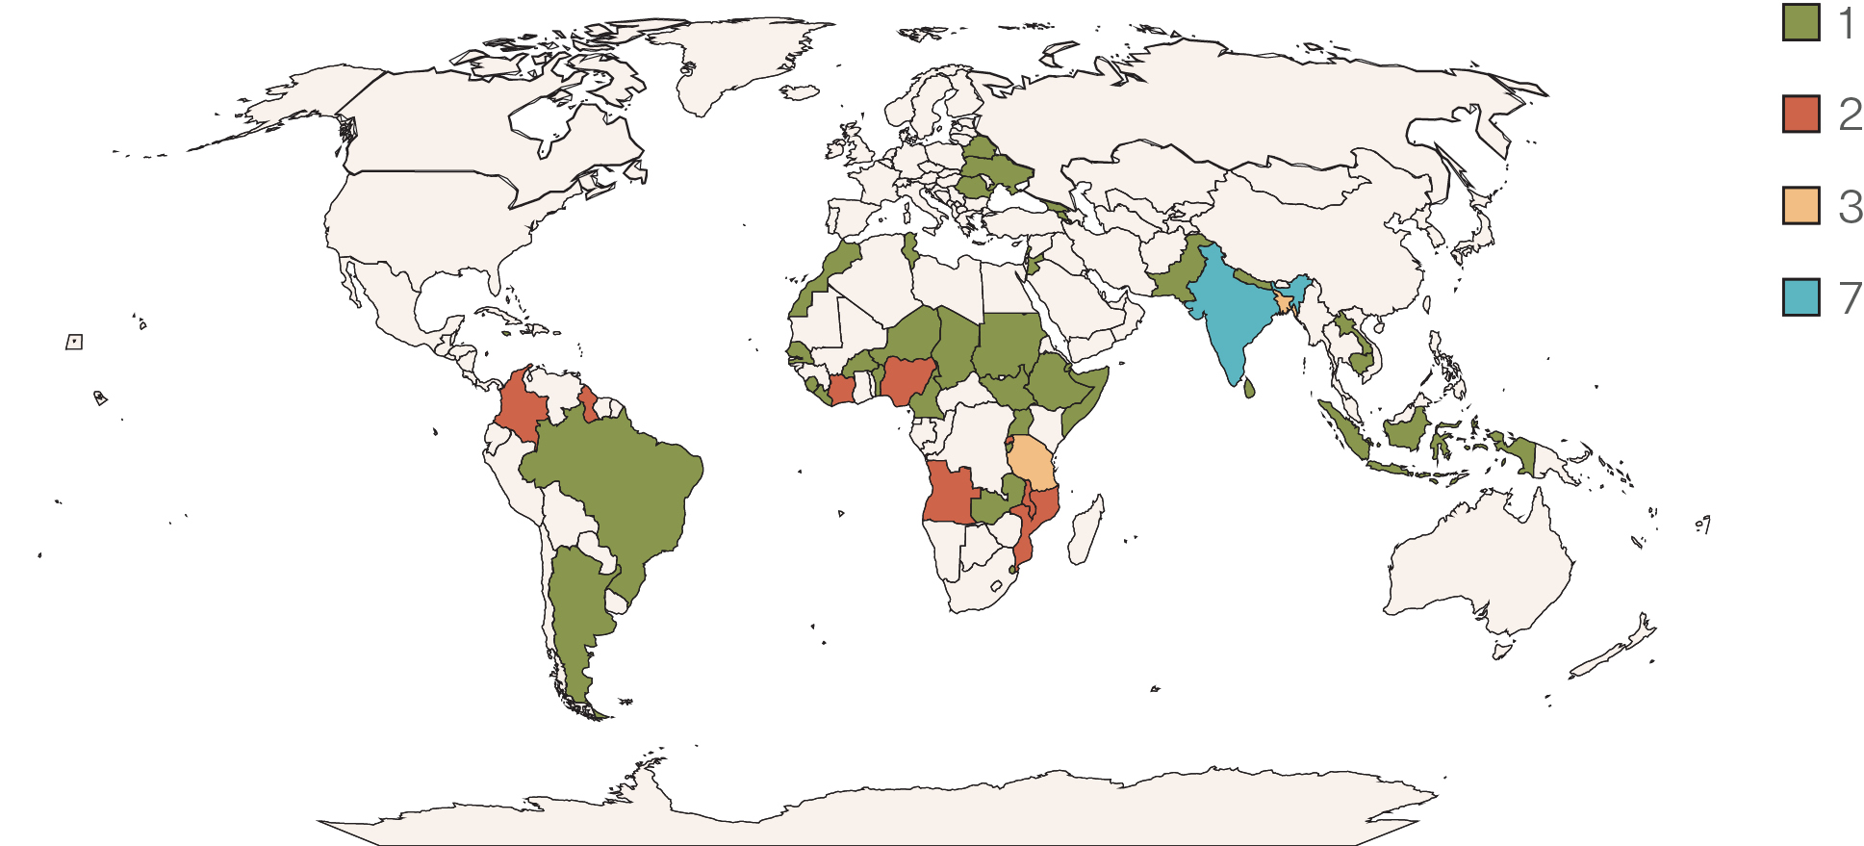
Examples of WBG engagements on skills, worker mobility, and GSPs
Technical assistance and convening
Leveraging operations on training, intermediation, and youth employment
on GSP coordination and design
Colombia, Ecuador, and the Dominican Republic with Spain
Tunisia with Italy
on national labor mobility systems
Philippines
Colombia
PNG
Source: World Bank Education Portfolio Database (2023 active projects)
Leveraging Kenya youth employment operation to support work pathways to Canada
Leveraging youth skills and TVET operation in Tonga to support overseas work
Bangladesh
Myanmar
Morocco
and many more…

Slide 18
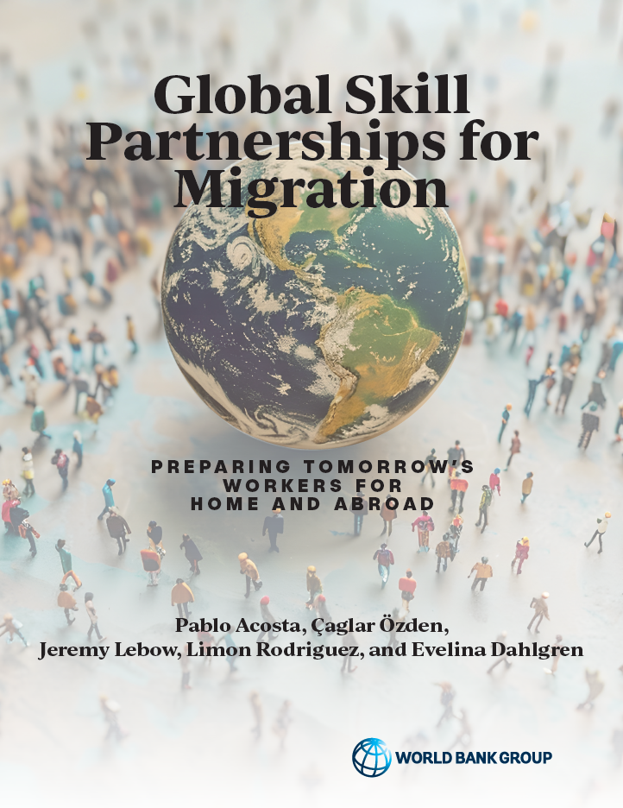

Suggested Reading
https://www.worldbank.org/en/topic/migration

