Slide 1


The Role of Skills and Diversity for Labour Productivity
in ADD Member States
Comparative Insights and Forward-Looking Strategies for Skilled Migration Management
31 January 2026, Dubai

Slide 2

WITH YOU TODAY
Murtaza Khan
Managing Parter
Middle East and Africa, Fragomen

Slide 3
Context
The world of work
is shifting
Roles are evolving faster than traditional qualifications or job structures can keep pace.
Capabilities matter
more than credentials
The focus has moved from degrees and titles to demonstrated ability and real-world competence.
Skills shortages
are growing
Across key sectors, demand for specialised talent exceeds current supply.
Governments are treating skills as strategy
Skills policy is now central to national goals for diversification and competitiveness.
Competence defines opportunity
Employability increasingly depends on skills performance, not just educational background.
Talent mobility is becoming borderless
Top talent gravitate towards countries that recognize and reward their skills.

Slide 4
Structure of the Presentation
01
02
03
Defining the Gig Economy
Workforce Demographics
and Skills Composition
Immigration Pathways for
Skilled Migration
04
05
Upskilling and
Reskilling Initiatives
Policy
Recommendations

Slide 5
Regional Context of
Skilled Migration

Slide 6

Different Approaches to Defining Skills
ILO Approach (ISCO-based)
OECD Framework
Industry 5.0
Five occupation groups: managers, professionals, technicians/associate professionals, clerical support workers, service/sales workers.
Skills-first approach emphasising cognitive, technical, transversal and disruptive skills.
Human-centric production prioritizing adaptability, creativity and cross-cultural collaboration.
1. Regional Context of
Skilled Migration
2. Workforce Demographics and Skills Composition
3. Immigration Pathways for Skilled Migration
4. Upskilling and Reskilling Initiatives
5. Policy Recommendations

Slide 7






Selected Examples of Skills Classification Frameworks
United Arab Emirates ISCO-based 9-level Professional Classification Scheme First five levels are considered skilled work Minimum education and salary level | Saudi Arabia Saudi Standard Classification of Occupations (SSCO) Three tiers: high-skilled, skilled and basic Three-tier classification relevant for work permit issuance | Qatar Qatari Standard Classification of Occupations (QSCO) Current version includes 3,711 distinct job titles organized in 5 main occupational categories No formal salary or education thresholds
India National Skills Qualification Framework National occupational standards are developed through Sector Skills Councils and the National Skills Development Corporation | Pakistan National Vocational Qualifications Framework TVET and RPL schemes are administered through National Vocational and Training Commission | Philippines The Philippine Skills Framework Competency testing administered through the Technical Education and Skills Development Authority
1. Regional Context of
Skilled Migration
2. Workforce Demographics and Skills Composition
3. Immigration Pathways for Skilled Migration
4. Upskilling and Reskilling Initiatives
5. Policy Recommendations

Slide 8
Historical Evolution of Labour Markets in the GCC
Pre-1930:
Traditional Economy
Reliance on pearl diving, fishing and small-scale trade
1973-1985:
Oil Boom Era
Sharp increase in foreign workers: from 1.25 million in early 1970s to 4.4 million by 1985
2007-2010:
Strategic Transformation
Financial crisis prompted re-evaluation of economic models
National Development Strategies with new skilled migration pathways
Massive infrastructure development projects
1. Regional Context of
Skilled Migration
2. Workforce Demographics and Skills Composition
3. Immigration Pathways for Skilled Migration
4. Upskilling and Reskilling Initiatives
5. Policy Recommendations

Slide 9
Workforce Dynamics and
Skills Composition

Slide 10
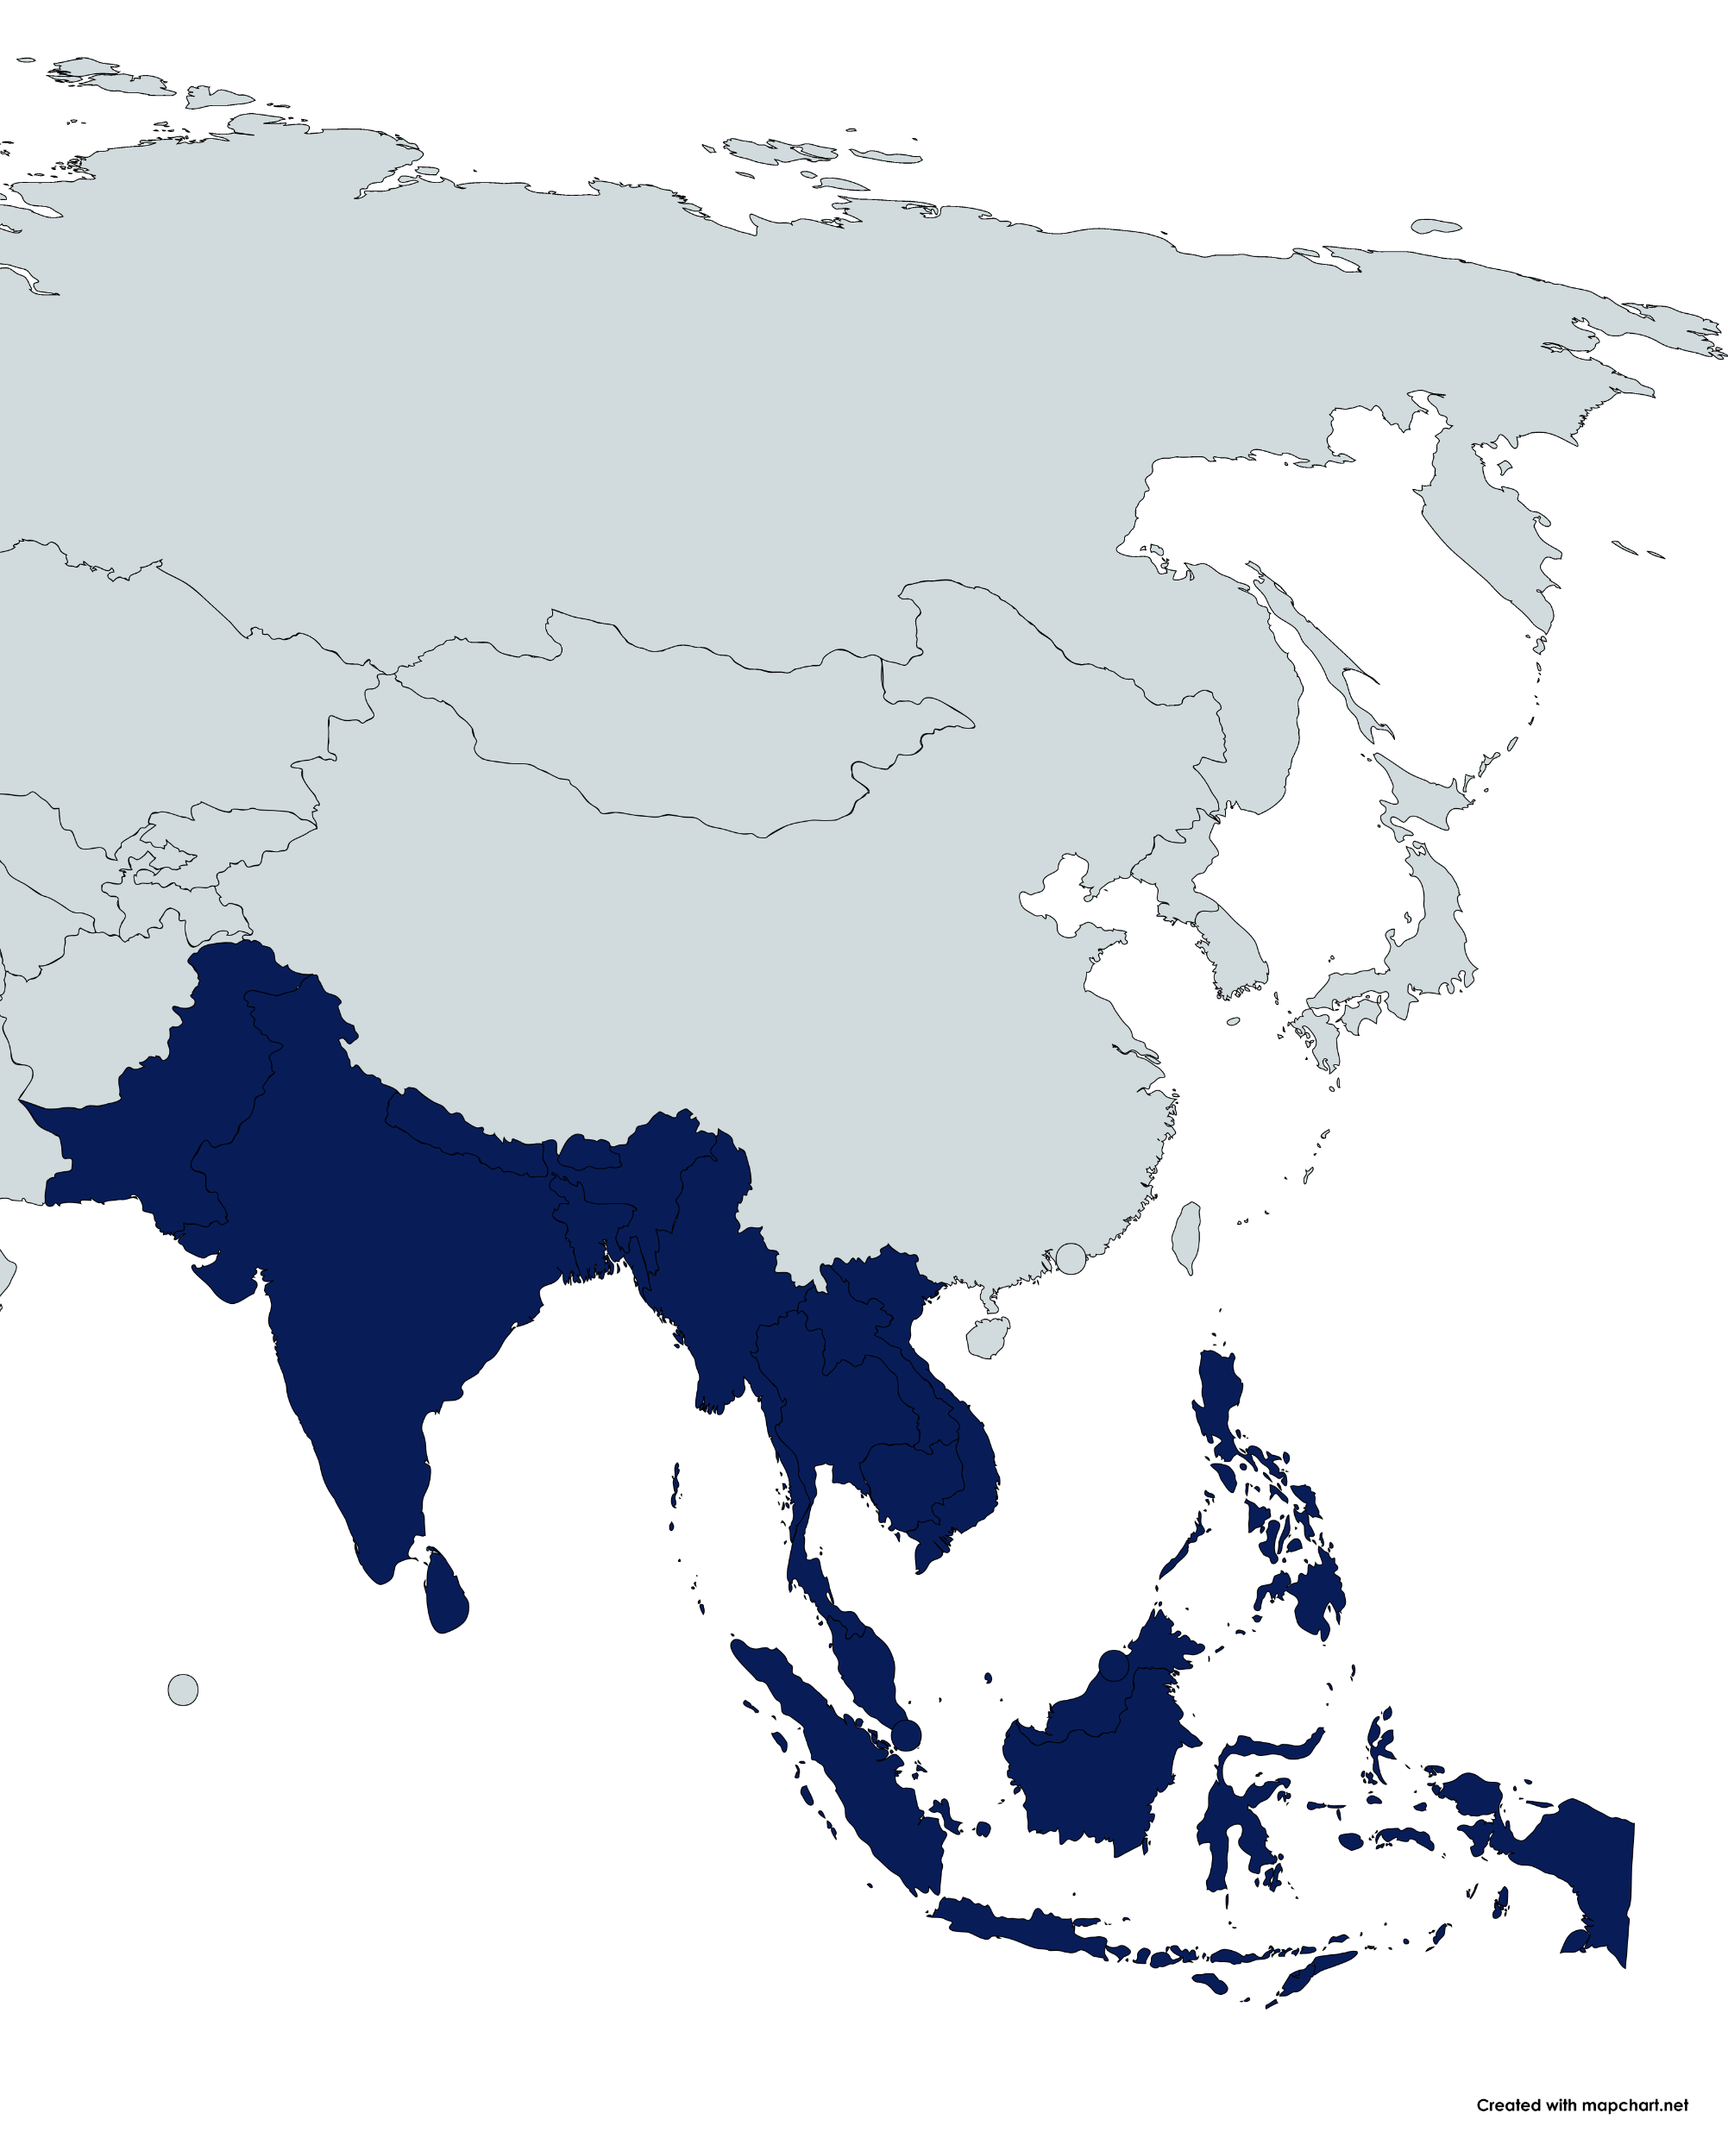
Skills Composition of Migrant Workers in the GCC
The majority of workers in the GCC are from South and Southeast Asia (Bangladesh, India, Indonesia, Pakistan, Philippines, Sri Lanka).
Most workers occupy low- and semi-skilled roles in construction, hospitality, domestic work and administrative jobs.
Differences in Labour-Sending Countries
Pakistan’s skilled workforce is close to 50%
Philippines & Sri Lanka have most diverse skills sets (clerical, technical, professional and managerial roles)
Nepal has seen rapid rise in skilled migration since the expansion of its TVET system
1. Regional Context of
Skilled Migration
2. Workforce Demographics and Skills Composition
3. Immigration Pathways for Skilled Migration
4. Upskilling and Reskilling Initiatives
5. Policy Recommendations

Slide 11
Skills Shortages and Mismatches in Recruitment Pipelines
Severe
AI & Robotics Renewables
Partial
Healthcare, Engineering
Adequate
Construction, Hospitality, General ICT
ICT Sector: Uneven Recruitment Patterns
Oman issued few ICT permits despite Vision 2040 demand
UAE and Saudi Arabia increased ICT recruitment (India, Egypt, Philippines).
India supplies high-skill ICT; Pakistan/Bangladesh focus on mid-level
Gaps in advanced technology (AI, data science)
Healthcare: Dependence on Specific Sending Countries
Philippines is a key supplier of certified nurses
Indian colleges supply many GCC nurses.
Pakistan/Bangladesh offer support roles, with limited advanced medical tech skills.
Limited Recruitment Pipelines for Renewables and Manufacturing
Geographical Concentration
UAE: Dubai attracts most skilled labour
Labour-Sending Countries: Training hubs in urban areas with limited rural access
1. Regional Context of
Skilled Migration
2. Workforce Demographics and Skills Composition
3. Immigration Pathways for Skilled Migration
4. Upskilling and Reskilling Initiatives
5. Policy Recommendations

Slide 12
Immigration Pathways for
Skilled Migration

Slide 13
Ecosystem for Attracting and Retaining Talent
Drivers
Facilitators
Talent Hubs
Presence of other talented
individuals leads to opportunities
for career advancement, collaboration, and further upskilling
Capital Infrastructure
Presence of infrastructure to support and reward entrepreneurship and innovation
Opportunity
Rapid returns on human-capital investments
The Immigration Program
Clear, fair and transparently applied immigration rules
Reasonable paths to permanent / long-term residence
Straightforward process for recognizing foreign qualifications and credentials
Opportunities for family members
Choice of Destination
Tolerance and Safety
Presence of a society that welcomes migrants (and their dependents) and embraces differences
Fair and Generous Social Model
Protections and opportunities that are offered to migrants
Lifestyle and Environmental Factors
Good quality of life and diver lifestyle choices
Drivers
Source: Competing Approaches to Selecting Economic Immigrants, Migration Policy Institute, 2019, Page 23.
1. Regional Context of
Skilled Migration
2. Workforce Demographics and Skills Composition
3. Immigration Pathways for Skilled Migration
4. Upskilling and Reskilling Initiatives
5. Policy Recommendations

Slide 14
Upskilling and
Reskilling Initiatives

Slide 15
Government Strategies for Upskilling and Reskilling
Labour-receiving countries
Labour-sending countries
Investment in National Talent
Overseas Employment
01
Nationalisation Policies to encourage Private Sector Participation
01
Alignment with International Certification Frameworks
Artificial Intelligence
Domestic Industries
02
All GCC countries have an AI Strategy/Roadmap and Flagship Programmes
02
TVET systems and Digital Skills
Regional Context of
Skilled Migration
2. Workforce Demographics and Skills Composition
3. Immigration Pathways for Skilled Migration
4. Upskilling and Reskilling Initiatives
5. Policy Recommendations

Slide 16
Government Strategies for Upskilling and Reskilling
Labour-receiving countries
Labour-sending countries
United Arab Emirates
World’s leading sovereign investor in AI
Flagship initiatives like One Million Arab Coders Programme (800,000+ learners)
Mohamed bin Zayed University of AI globally recognised
India
Sector-specific training through Skill India International Centres
Training in AI, robotics and green energy available through India’s Skills Accelerator
01
Saudi Arabia
Establishment of Saudi Data and AI Authority
780,000+ citizens trained in digital and AI skills
Sector Skills Council identified 12 priority industries aligned with Vision 2030
Thailand
Incentives private sector upskilling through generous tax deductions
250% on digital training expensed and 150%on salaries for new digital hires
02
02
Regional Context of
Skilled Migration
2. Workforce Demographics and Skills Composition
3. Immigration Pathways for Skilled Migration
4. Upskilling and Reskilling Initiatives
5. Policy Recommendations

Slide 17
Businesses Perspectives across the ADD Corridor
Employer Approaches to Upskilling and Reskilling
Impact of Emerging Technologies on Workforce Skills
Source: Fragomen Survey on Assessing Workforce Skills and Upskilling Strategies in Private Sector Companies (2025).
Regional Context of
Skilled Migration
2. Workforce Demographics and Skills Composition
3. Immigration Pathways for Skilled Migration
4. Upskilling and Reskilling Initiatives
5. Policy Recommendations

Slide 18
Policy Recommendations

Slide 19
Harmonize Skills Classification Frameworks
Credential Recognition and Portability
Work towards harmonised classification frameworks across the corridor, drawing on international standards such as the ILO’s International Standard Classification of Occupations (ISCO) and building on national initiatives, to reduce recognition gaps and improve portability of qualifications.
Talent Receiving Countries
Consolidate and expand skills verification and recognition systems to significantly reduce credential validation timelines.
Partner government-led credential verification mechanisms with independent organizations that provide primary source verification or credential evaluation services for both academic and vocational qualifications.
Incorporate pre-departure verification mechanisms in partnership with TVET agencies and credentialing bodies in origin countries to reduce skills mismatches and costs.
All ADD Member States
Establish an ADD-wide skills governance mechanism to harmonise occupational standards, coordinate sectoral upskilling funds and map training programmes to corridor-wide categories
Talent Sending Countries
Align curricula with Gulf taxonomies and negotiate mutual recognition agreements to shorten credentialing delays.
Ensure pre-departure orientation covers sector-specific training, language preparation and digital readiness to improve worker adaptability on arrival.
Establish national credentialing bodies and digital credentials repositories that can interface directly with Gulf verification systems or authorized third-party intermediaries.
All ADD Member States
Talent Receiving Countries
Talent Sending Countries
Regional Context of
Skilled Migration
2. Workforce Demographics and Skills Composition
3. Immigration Pathways for Skilled Migration
4. Upskilling and Reskilling Initiatives
5. Policy Recommendations

Slide 20
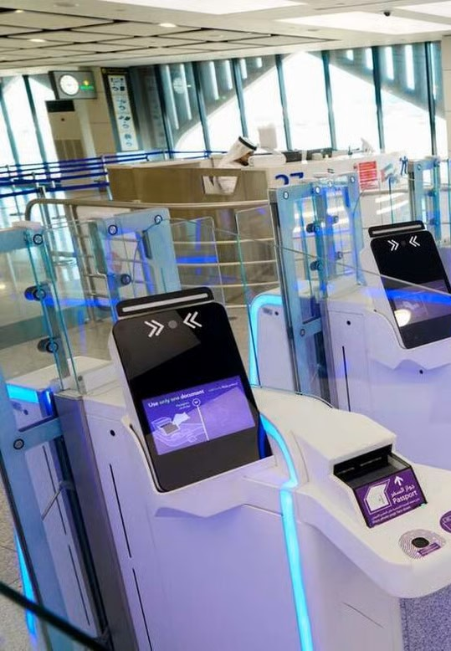
Inclusive Immigration Pathways
Talent Receiving Countries
Expand beyond residency schemes catered to high-impact or high-visibility roles or skill sets and include strategically important or technically nuanced roles that may not be very senior in nature but are important to address local skills gaps.
Introduce temporary and intra-company transfer visas in a timely manner, as seen in international practice, to enable rapid deployment of skilled staff and to facilitate knowledge transfer.
Talent Sending Countries
Design inclusive outbound mobility programs that actively support participation from underrepresented groups, including women, youth from rural areas and persons with disabilities.
Expand pre-departure support systems to offer tailored guidance, legal literacy and sector specific preparation for diverse migrant cohorts.
Talent Receiving Countries
Talent Sending Countries
Regional Context of
Skilled Migration
2. Workforce Demographics and Skills Composition
3. Immigration Pathways for Skilled Migration
4. Upskilling and Reskilling Initiatives
5. Policy Recommendations

Slide 21
Public-Private Partnerships
Private Sector Discussion Forums
Talent Receiving Countries
Enable structured private sector participation in identifying and addressing skills gaps through forums, research collaborations and trusted partner schemes.
Provide incentives and access mechanisms for small and medium-sized enterprises (such as training subsidies or skills credits), ensuring they can participate equitably in upskilling initiatives.
Design agile and holistic nationalisation policies that balance the placement and advancement of citizens into leadership roles and strategic positions with an open, inclusive and business-friendly framework for skilled expatriate workers and avenues for businesses to voice feedback or seek recourse in the event of skills unavailability in the local market.
Increase transparency in nationality diversification rules, giving employers clarity to plan recruitment while still supporting governments’ demographic objectives.
Talent Sending Countries
Expand specialised training centres and sector-focused academies in priority fields such as healthcare, renewable energy and digital technologies, in partnership with employers and international organizations.
Leverage diaspora networks and returning professionals to co-develop training programs and mentorship schemes.
Establish national forums that engage employers, training institutions and returning migrants to gather feedback on workplace inclusion challenges abroad.
Promote gender-inclusive training programs and ensure women are represented in outbound labour mobility schemes.
Talent Receiving Countries
Talent Sending Countries
Regional Context of
Skilled Migration
2. Workforce Demographics and Skills Composition
3. Immigration Pathways for Skilled Migration
4. Upskilling and Reskilling Initiatives
5. Policy Recommendations

Slide 22
Three Main Building Blocks
PUBLIC
PRIVATE PARTNERSHIPS
TALENT
ECOSYSTEM
SKILLS
CLASSIFICATION FRAMEWORKS
Regional Context of
Skilled Migration
2. Workforce Demographics and Skills Composition
3. Immigration Pathways for Skilled Migration
4. Upskilling and Reskilling Initiatives
5. Policy Recommendations

Slide 23
THANK YOU

