Slide 1
ADD inter-regional study
Labour Mobility, Skills, and Social Protection for a Just Transition to Green Economy
Mette G Lund, Regional Just Transition Specialist, Arab States, ILO

Slide 2
The just transition imperative in the ADD corridor
How climate change impacts jobs and labour migration
How climate change policies impacts jobs
What a just transition means in the ADD corridor
Inter-regional study outline

Slide 3
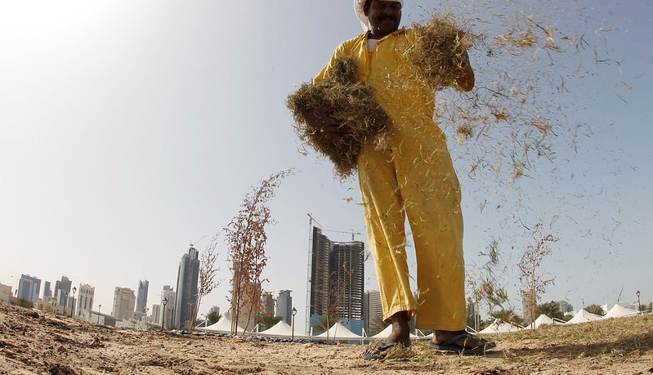
Part 1 Climate change impacts on the World of Work

Slide 4
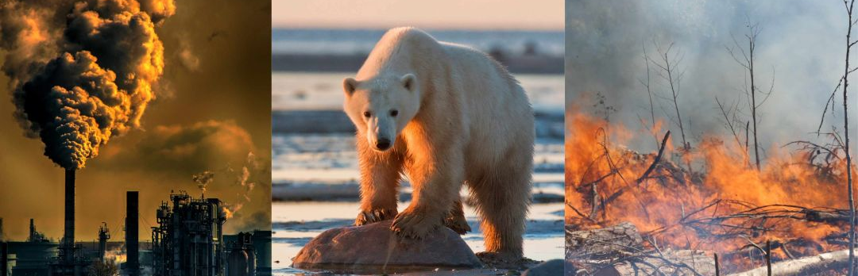

How does climate and the World of Work relate?
Triple planetary crisis (Pollution, Climate change, and biodiversity loss)
Climate and environmental policies (NDCs, environmental/climate regulations, carbon markets etc)

Slide 5
How does climate change affect the world of work – different impacts on different groups
Natural disasters
Changing exposure to diseases
Heat stress
Rural & urban
Youth and older workers
Women and men
People in poverty
Loss of work hours
Occupational health and safety risks
Lower labour productivity
Climate migration
132 Million People could fall into extreme poverty by 2030

Slide 6
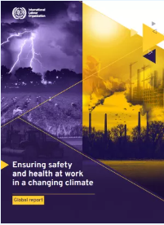
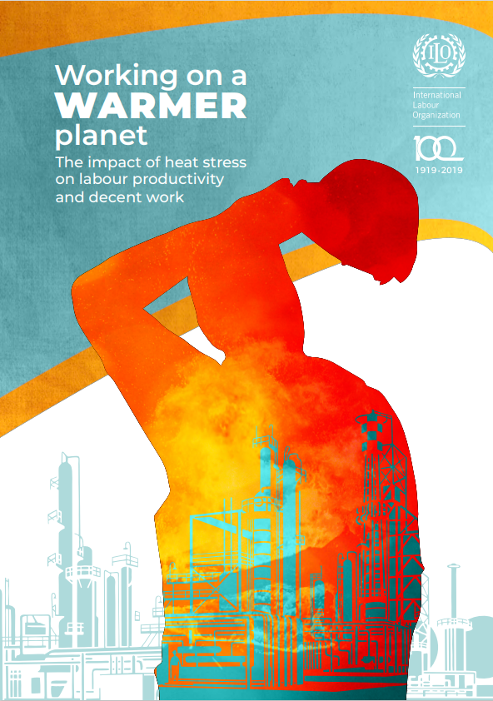
Human and health related climate change risks
At least 2.41 billion workers exposed annually to excessive heat at work. Temperatures above 24–26°C = reduced labour productivity. At 33–34°C = 50% of work capacity lost (ILO, 2019)
Every year, 22.85 million occupational injuries, 18,970 work-related deaths, and 2.09 million disability-adjusted life years (DALYs) attributable to excessive heat.
1.6 billion workers exposed to UV radiation, with more than 18,960 work-related deaths annually from nonmelanoma skin cancer.
Migrant workers are often concentrated in sectors as particular risk and are particularly vulnerable to poor working conditions

Slide 7
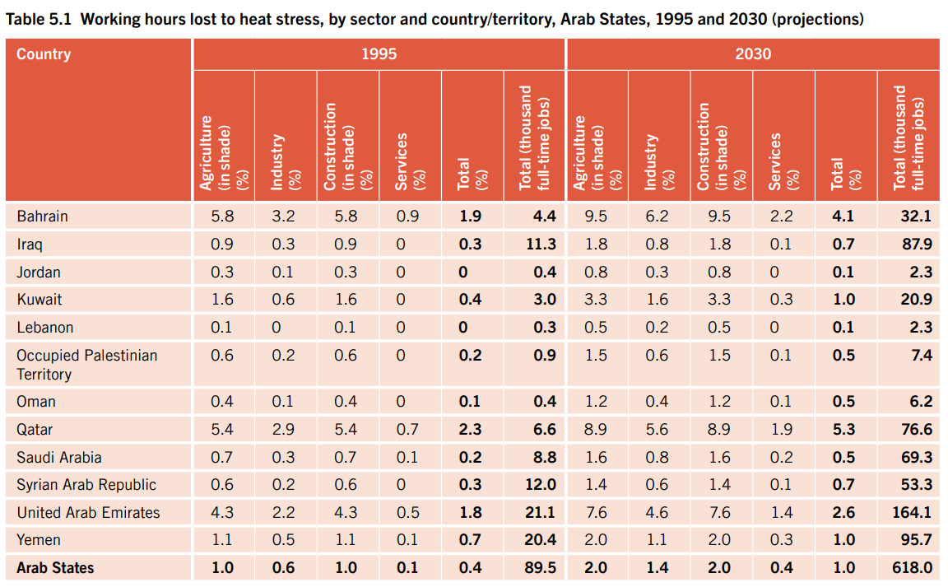

Slide 8
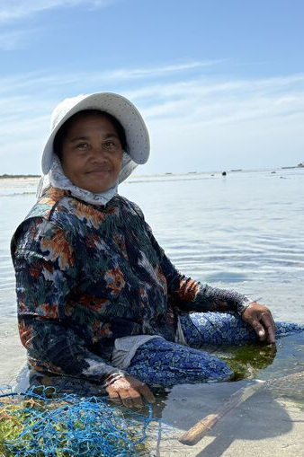
Climate change and labour migration
Challenges
Existing vulnerabilities being exacerbated by climate change
Various kinds of migration; planned, forced, regular, irregular, internal, external, inter-regional etc.
Opportunities
Economic growth leading to new business and employment opportunities
Specific skills and labour needs not being met by current labour market

Slide 9
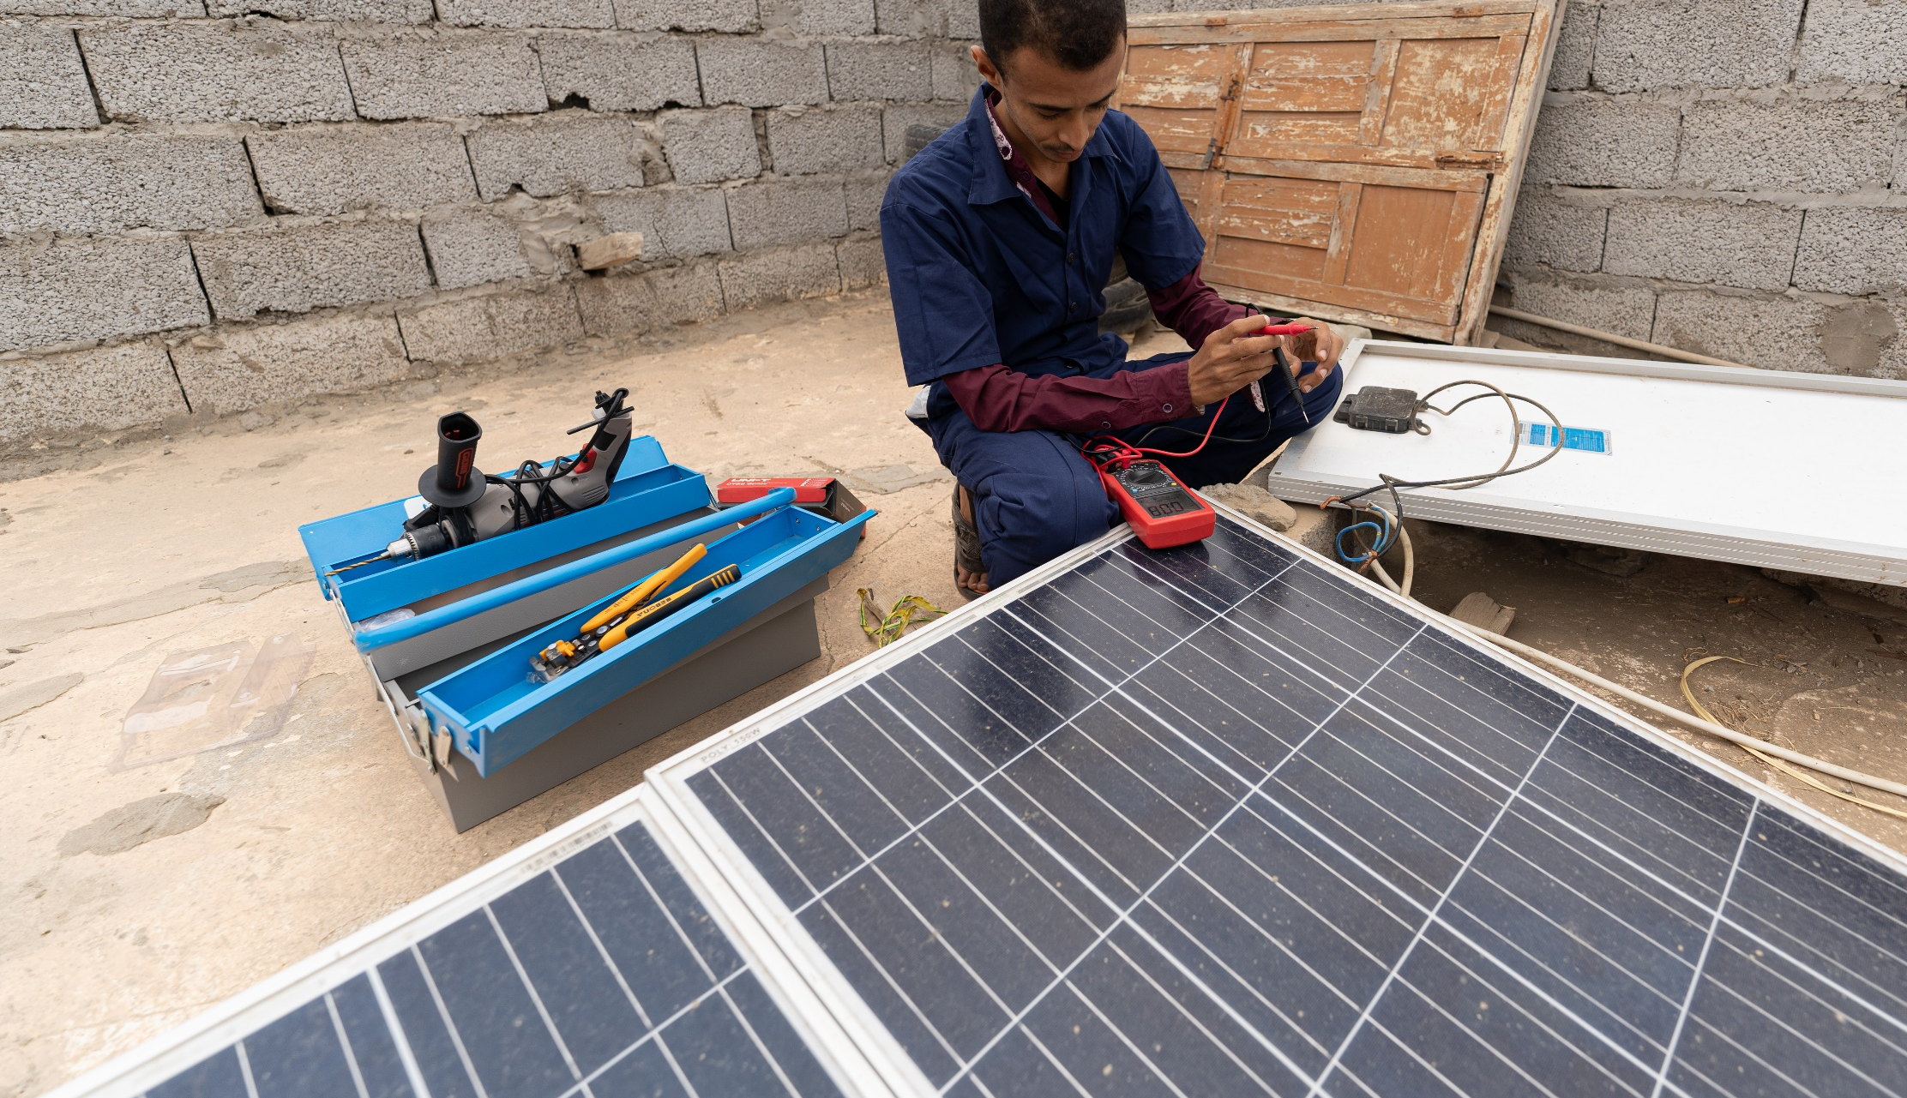
Part 2 Climate change policies and the effect on the World of Work

Slide 10
How does climate policies and the World of Work relate?
Triple planetary crisis (Pollution, Climate change, and biodiversity loss
Climate and environmental policies (NDCs, environmental/climate regulations, carbon markets etc)

Slide 11
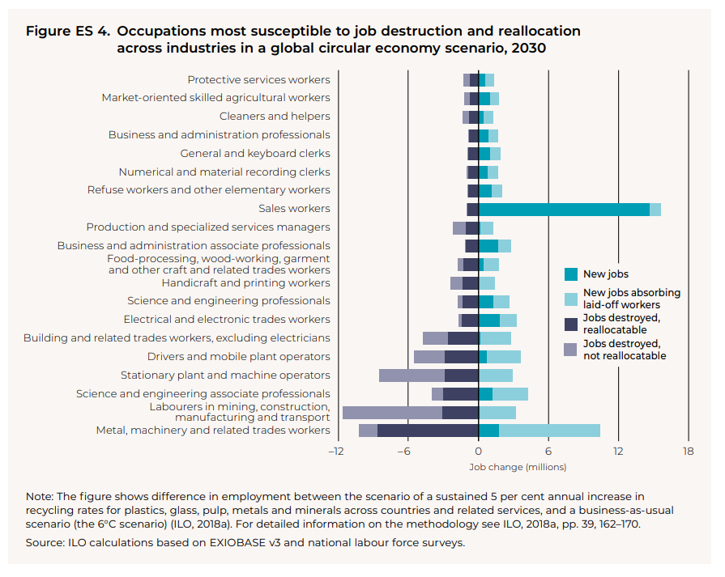
Greening the economy will impact jobs in 4 main ways
Greening the economy will impact jobs in 4 main ways e.g. the circular economy scenario which can show future high-growth sectors for labour planning
Shift to greener economies
New jobs created
Some jobs eliminated
Some jobs redefined
Some jobs substituted
Notes:
First, additional jobs will be created.
Second, some employment will be substituted—as in shifting from fossil fuels to renewables, or from truck manufacturing to rail-car manufacturing.
Third, certain jobs may be eliminated without direct replacement. – e.g. with the ban of certain materials.
Fourth, it would appear that many existing jobs (especially such as plumbers, electricians, metal workers, and construction workers) will simply be redefined as day-to-day skill sets, work methods, and profiles are greened.

Slide 12
Climate change scenarios and employment projections (the MENA example)

Slide 13

MENA scenarios
Current Policies Scenario (BASELINE): Existing policies up to 2022 are implemented in the MENA countries and projected to 2030.
Nationally Determined Contributions Scenario (NDC): MENA countries deliver their NDC targets by 2030; but fail 1.5C pathway & climate neutrality.
Strong Industrial Policy Scenario: MENA region deliver net zero emissions (in CO2) by 2050, in line with a global 1.5C pathway. Implement industrial policies and just transition polecies
Climate Resilience Scenario: MENA achieve net zero emissions by 2050
Notes:
Scenario 3
Industrial policies: Green hydrogen, Solar power export, e-vehicles
Just transition policies: compensating oil royalties, profits and stranded assets, as well as reskilling and relocation.
Scenario 4
Assuming A regional fund is established, financing resilience, adaptation, water desalination, waste recycling and reforestation.

Slide 14
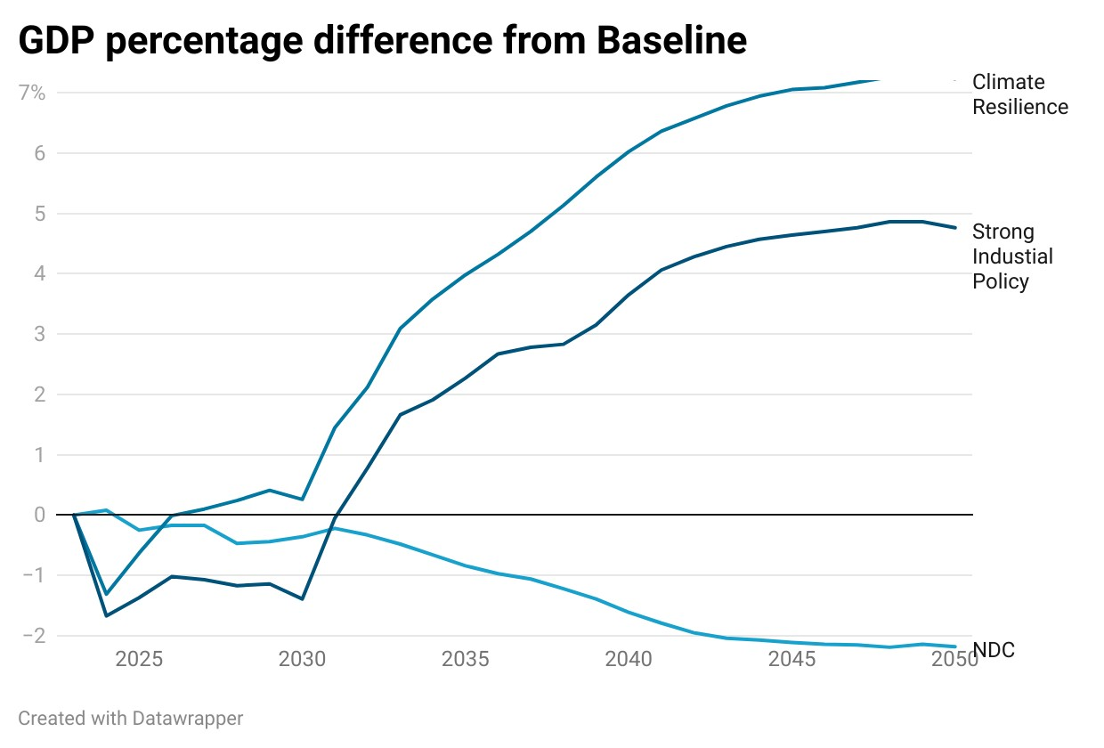
GDP impacts
NDC – GDP loss of 2.3% compared to baseline
GDP reduction driven by loss of exports in oil & gas due to reduced global demand without replacement
Strong Industrial Policy – GDP gain of 4.8% compared to baseline
Long-term positive impact due to higher levels of green-tech investment
Short-term negative GDP impact: increased electricity costs due to carbon pricing. Cost of green-tech decrease over time due to endogenous learning-by-doing.
Climate Resilience – GDP gain of 7.2% compared to baseline:
Additional investments in water desalination and reforestation which is funded at no cost by overseas resources.

Slide 15
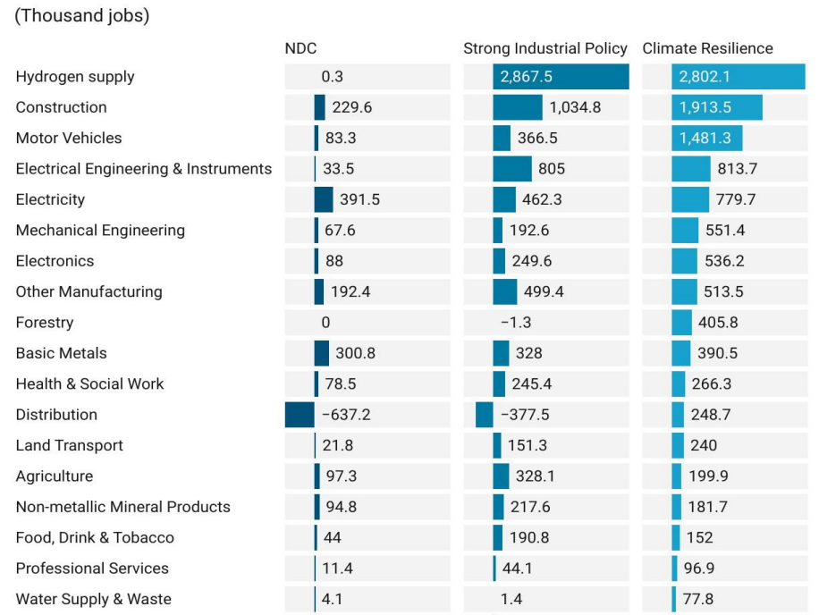
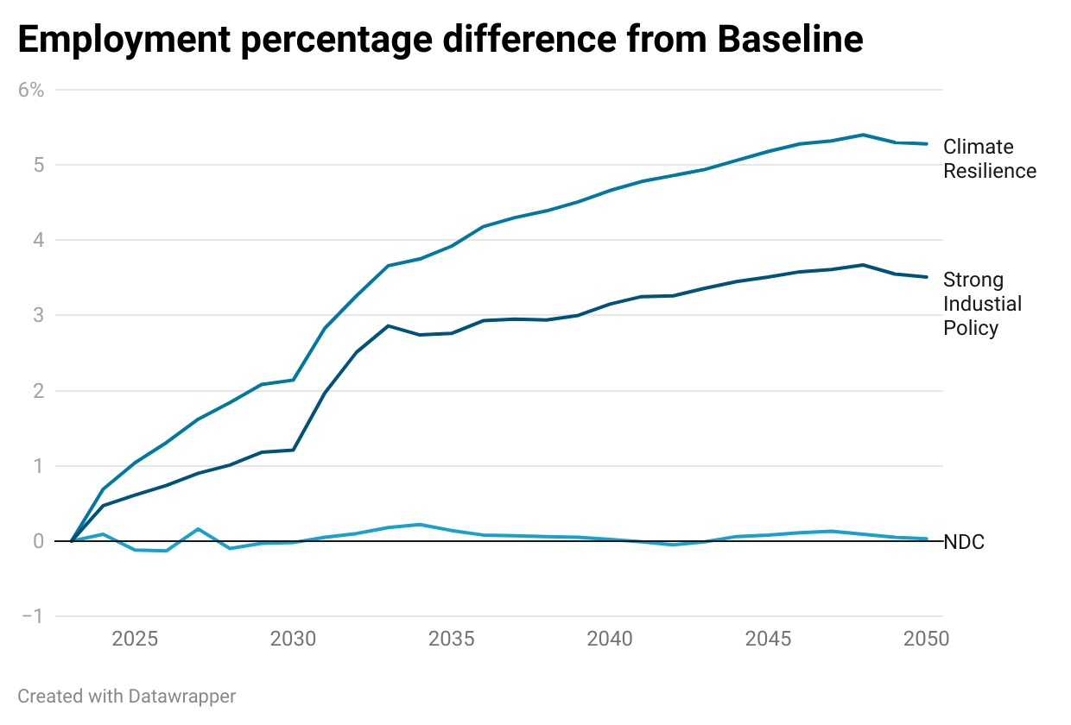
Up to 10 million new jobs; 2 million require restructuring
Sectoral impacts – Job gains
Notes:
Up to 10 million new jobs; 2 million require restructuring
NDC:
Negligible impacts on employment (oil & gas is capital intense)
Strong Industrial Policy - 6.6 million new jobs
Long-term positive job impact driven by green-tech investments and household consumption (wage improvements).
Climate Resilience – 10 million new jobs
Additional investments in water desalination and reforestation are labour intense
Financing of regional fund including for skills and labour market policies (~5% )

Slide 16
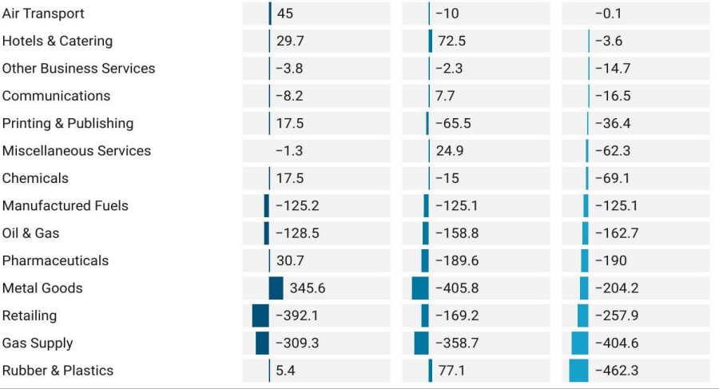
Sectoral impacts – Potential job losses
Negative impacts on Gas supply (360,000), Oil & Gas production (160,000) and manufactured fuels (125,000), due to fall in demand for fossil fuels.
Public services see reduced employment due to reduced government spending as result of lost oil royalties and stranded assets compensations.
Higher recycling rates lead to a noticeable shift from rubber & plastics to recycling.
Support restructuring of some 2 million jobs
Skills training, reskilling and upgrading
Social protection
Green Entrepreneurship & Enterprise development
Inclusion of women and youth, migrant workers and most vulnerable groups (to address existing structural inequalities in the labour market)

Slide 17
However, this transition is not automatically easy or smooth…

Slide 18

Challenges in the transition
Temporal misalignment
Spatial misalignment
Sectoral misalignment
Educational misalignment
What will we do about this? The just transition argument Skills and social protection as enablers

Slide 19

Part 3 The just transition response to climate change

Slide 20
The need for a just transition
Impacts on the structure of economies, on jobs, on equity
Climate and environmental change
Need for a just transition
Impacts on the structure of economies, on jobs, on equity
Responses to climate and environmental change

Slide 21
The definition of just transition and other related transition concepts
Just transition
Green transition
Equitable transition
Fair transition
Inclusive transition
Gender equality
Maximizing the social and economic opportunities of climate action, while minimizing and carefully managing any challenges – including through effective social dialogue among all groups impacted, and respect for fundamental labour principles and rights.
ILO Guidelines for a just transition towards environmentally sustainable economies and societies for all
A Just Transition means greening the economy in a way that is as fair and inclusive as possible to everyone concerned, creating decent work opportunities and leaving no one behind.
All sectors, all countries.

Slide 22
The journey of the just transition concept
1980’s Labour Union movement
2013 102nd ILC general discussion: Decent work, green jobs, and sustainable development
2013 19th ICLS statistical guidelines on green jobs
2023 ILC General Discussion on Just Transition
2015 ILO Just Transition Guidelines adopted by an ILO meeting of experts
2018 COP24 Just Transition Declaration
2019 Climate Action for Jobs Initiative
2021 COP26, Glasgow, Just Transition Declaration
2021 First Just Energy Transition partnership signed w. South Africa
2022 COP27 Sharm el Sheikh, Just Transition Work Programme
2023 COP28 Dubai Just Transition Work Programme
2015 Paris Agreement
Notes:
A just transition addresses climate change in a holistic and whole of society manner.
That means, that we must ensure that climate action is socially just and fair.
For example, ILO research shows that a green energy transition will create 25 million jobs. However, 7 million jobs will be lost globally. While that is a net job growth potential of 18 million globally, it is absolutely key for economic and social development to make sure that those 7 million people losing their job will not be left behind.
That’s why a just transition is important!
On my next slide I will dive into the guidelines more specifically.

Slide 23
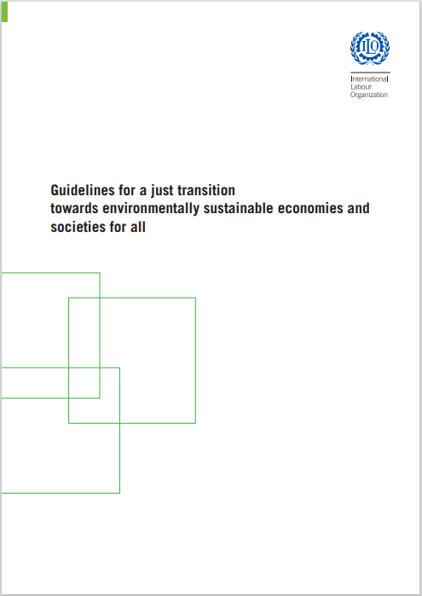

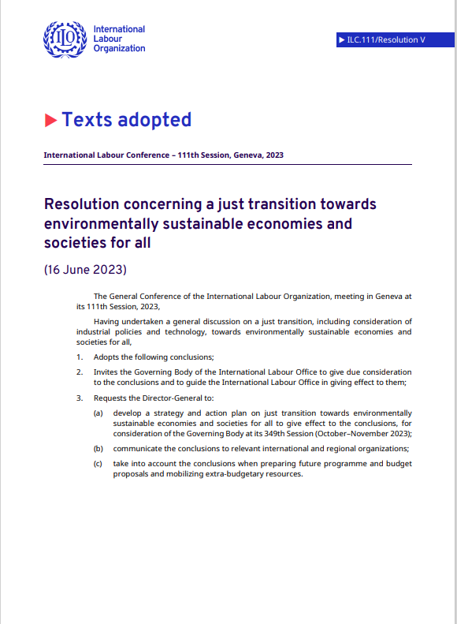
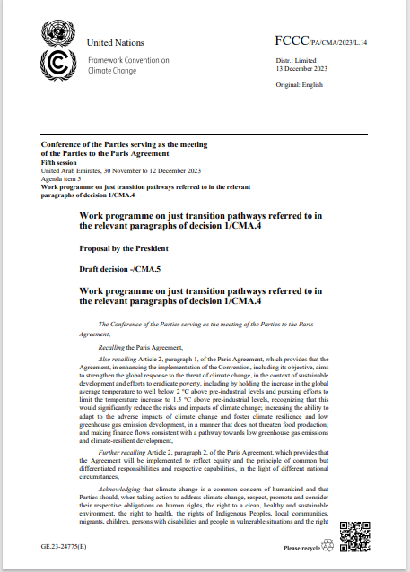
Two key ILO agreements
Two key UNFCCC agreements
+ other international agreements
related to just transition in
IOM and OHCHR
ILO Just Transition Guidelines are developed by a the world of work actors, and endorsed by ILO constituents by the ILC
ILC 2023 on just transition and labour mobility
“Formulate coherent just transition frameworks for labour mobility schemes that advance decent work, skills mobility and development, and poverty reduction with special consideration given to least developed countries and small island developing States”

Slide 24
The ILO just transition guidelines include a set of guiding principles
Social dialogue and
FPRW
Gender and equity
Policy coherence
Decent jobs
No one size fits all
International cooperation

Slide 25
The ILO just transition guidelines include 9 policy areas for a holistic response to climate change
Macroeconomic and growth policies
Industrial and sectoral policies
Enterprise policies
Skills development
Occupational safety and health
Social protection
Active labour market policies
Rights
Social dialogue and tripartism

Slide 26








Current trends in key policy and implementation areas for a just transition
Macroeconomic and growth policies Ensuring fiscal space for social spending, and using financial steering instruments can expedite green transitions
Increased focus on industrial policies and technology with potential impacts of global trade and investment.
Smart use of incentives, creation of an enabling business environment, and regulatory practices for due diligence can unleash the potential of the private sector for enterprise development.
Anticipating skills needs and strengthening systems to provide equitable access to skills and lifelong learning for all individuals, including those in the informal economy, is still constrained in many countries
Social protection is a facilitator of, not just a buffer for, a just transition. Social protection policies together with active labour market policies can ease and accelerate transition leaving no one behind.
International labour standards, including the right to freedom of association and the right to a safe and healthy working environment and gender equality, are not often part of the just transition policies – scope for normative dialogue.
Social dialogue and collective bargaining has been used to build consensus for some, but not all, policy processes.
Mobilizing public and private finance from domestic and international sources. Leveraging the expertise and resources of IFIs and MDBs and aligning financial flows.
Notes:
Without going into details on how each of the policy areas relate to the central elements of just transition, we would like to highlight some recent developments in some key policy areas.
There is an increasing interest to discuss pro-employment macro policies and there is an active policy debate on the appropriate use of financial steering mechanmisms, such as taxes and incentives, to finance and incentivise just transition.
Alongside with macroeconomic fundamentals, also industrial and sectoral policies have been employed to promote juts transition, especially in the key sectors needed for environmental sustainability. However, a narrow focus on the polluting sectors is not enough, a transition will need an economy-wide approach to stimulate the transition of workers and technologies and to ensure a just transition.
The private sector is a key actor and is many times driving a positive change by innovating new technologies and adopting new practicies. This puts new demands for the public sector to revise the regulatory environment and provide incentives for new innovation while regulating the market and ensuring due diligence to avoid adverse practices. How this will pan out in different countries will require a context-specific analysis of the sectors and constraints.
While many jobs will be created (and some will be destroyed), we know that almost all jobs will be changing. Thus ensuring that we are analysing and anticipating skills needs and streghnening our systems to provide life-long learning for all population groups, including the informal actors, is important. Unfortunately many countries are struggling to put in place the needed policies, systems and financing mechanisms.
The traditional role of social protection has been to serve as a buffer, but increasingly the emphasis has shifted to using social protection together with active labour market policies to actively promote transitions that will come, and to provide security for workers to search for the new opportunities and skills needed.
We see that a lot of the policy debate is on technical aspects and many times the rights issues have not gained as much attention. Yet, a just transition provides an opportunity to promote e.g. gender equality and a normative change, and thus being able to articulate these opportunities and their importance is needed.
In some cases, there has been a constructive social dialogue that has been used to negotiatie the new just transition policies – but this is by far not the norm.
To consider: Given the complementarity of mandates, roles and levers to stimulate change, cooperation and partnerships between public and private finance actors is important to ensure sufficient investment for a just transition. According to the UN High-Level Climate Action Champions, the private sector could be able to deliver up to 70% of total investments to meet net zero goals. Private sector banks, investors, insurers and asset owners have levers at their disposal to allocate capital for a just transition and influence the transition process taking place in the real economy.

Slide 27
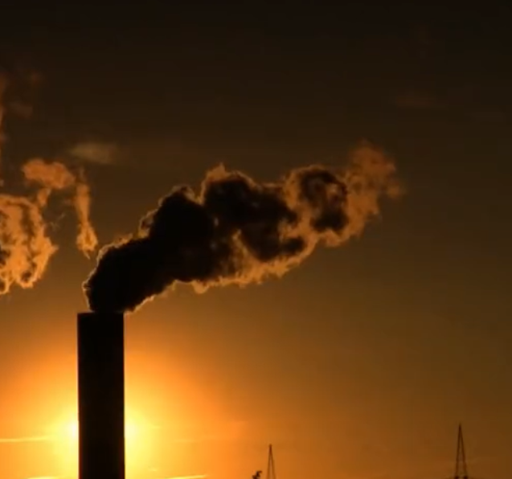
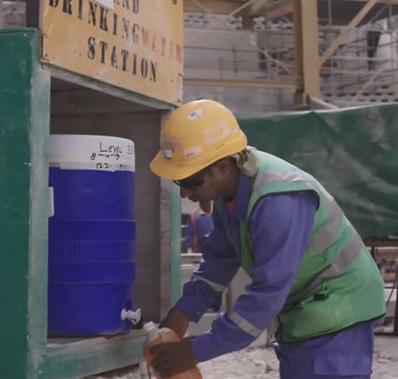
Example: Closure of coal mines in Spain
‣ Employment in coal mining sector: 45,000 in 1990 → 1,700 in 2017
‣ 2018 commitment to close the remaining coal mines
‣ Just Transition Strategy developed in 2019 and deal struck between unions and government which included:
‣ Early retirement schemes
‣ Local re-employment in environmental restoration work
‣ Re-skilling programs for green industries
Lessons:
→ Integrated policies packages needed from the start to move beyond protection: social protection measures can maintain consumption levels, but reactivation measures needed for transition.

Slide 28


Example: Phasing out fossil fuel subsidies in Morocco
‣ Fossil fuel subsidies prevent decarbonisation - governments agreed to phase out inefficient fossil fuel subsidies (COP26 Glasgow)
‣ Between 2011 – 2015, Morocco phased out fossil fuel subsidies and reinvested part of savings to expand social protection:
‣ Conditional cash transfer for children: 80k to 466k families
‣ Social health insurance for low-income households: 5.1m to 8.4m
Lessons:
→ Compensation key element to ensure public acceptability
→ As is strong social dialogue and communication of rationale for reform

Slide 29
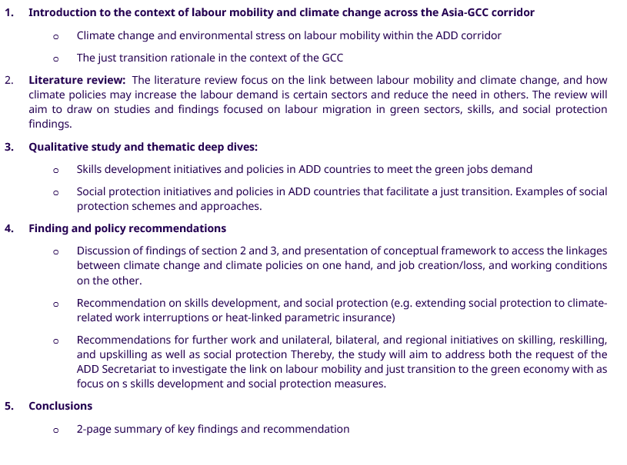
ADD inter-regional study Labour Mobility, Skills, and Social Protection for a Just Transition to Green Economy in the GCC-Asia Corridor
Does this outline address the questions and concerns of the ADD?
Any topics or perspectives missing?
Further guidance from the ADD?

