Slide 1
VIRTUAL LABOR MOBILITY: BRINGING OPPORTUNITIES HOME
Abu Dhabi Dialogue
Rada Naji

Slide 2
“Technological disruption, particularly digitalization and artificial intelligence, offers both the risk of being left behind and the chance to leapfrog into more competitive, inclusive economies” Embracing and Shaping Change, Human Development for a Middle East and North Africa in Transition (World Bank, 2025)

Slide 3
What is Virtual Labor Mobility ‘VLM’?
Virtual-migrants are defined as cross-border’s online workers who live in one country but provides services to a client in another country, either through a domestic or international employer.
VLM Includes a variety of contractual arrangements, as workers may be formally employed by a company or operate as self-employed professionals.
VLM includes platform-based gig work.
A renewed perspective. Most available literature explores cross borders online work from the ‘service trading’ angle, with fewer reports that address it from a ‘global labor market’ perspective.
Location of the client
Is the worker providing services directly to a client located in a different country?
Yes
No
Type of employment
Wage work
Self-employment
Includes online freelancers and online gig workers serving international clients
Self-employment
Includes freelancers, gig workers, and other self-employees providing services to local clients
Wage work
wage workers for domestic companies, so long as services are provided to international clients
wage workers for international companies, so long as services are provided to international clients
wage workers for domestic companies, so long as services are provided to local clients
wage workers for international companies, so long as services are provided to local clients
Cross-border remote workers
In-person and within-country remote workers
Notes:
although the two can overlap. Cross-border gig work includes graphic designers and translators providing services to international clients via platforms like Upwork, Fiverr, or TaskRabbit. However, it does not include location-based platform workers, such as Uber.

Slide 4
Why is it valuable for countries and employers?
It achieves the same benefits as physical labor mobility
Addresses labor shortages in receiving countries.
And offers even more
Cost efficiency: no physical relocation expenses and adjusting compensation based on the cost-of-living in the country of origin.
Access to a larger pool of talents: anyone with the right skills can be your employee, including those that are not eligibile (or don’t want) to relocate.
Contributes to the economy of sending countries: increased employment with domestic firms, multiplier effect, mitigates full brain drain of young people.
Less sensitive politically and socially.
Can be a steppingstone to physical migration, allowing the destination firms to ‘choose’ the best of the best.
Workers from origin countries earn higher wages.
Reduces poverty through remittances.
Fosters knowledge transfers in the origin countries.

Slide 5
Why is it valuable for workers?
It allows the talented to stay ‘home’ if they want to, without accepting lower-skilled jobs, especially in countries where there is a supply/demand mismatch.
Benefits immobile vulnerable groups that can gain access to better job opportunities in their countries of origin without the need to cross borders.
Holds potential for expanding opportunities among individuals at the bottom of the skill distribution (the medium skilled can also hold virtual jobs).
Allows the workers to learn on the job, gaining new skills as they serve international clients and/or international employers.

Slide 6
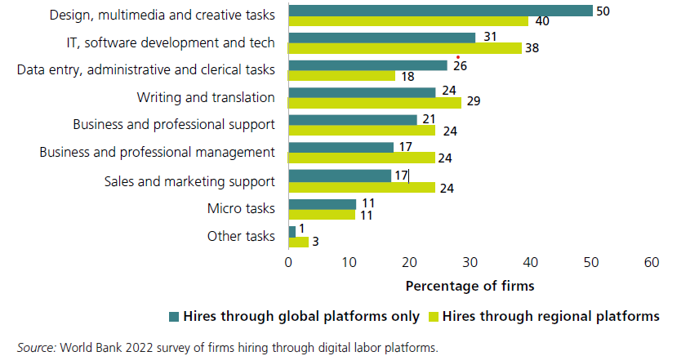
What are virtual occupations? (Snapshot)

Slide 7
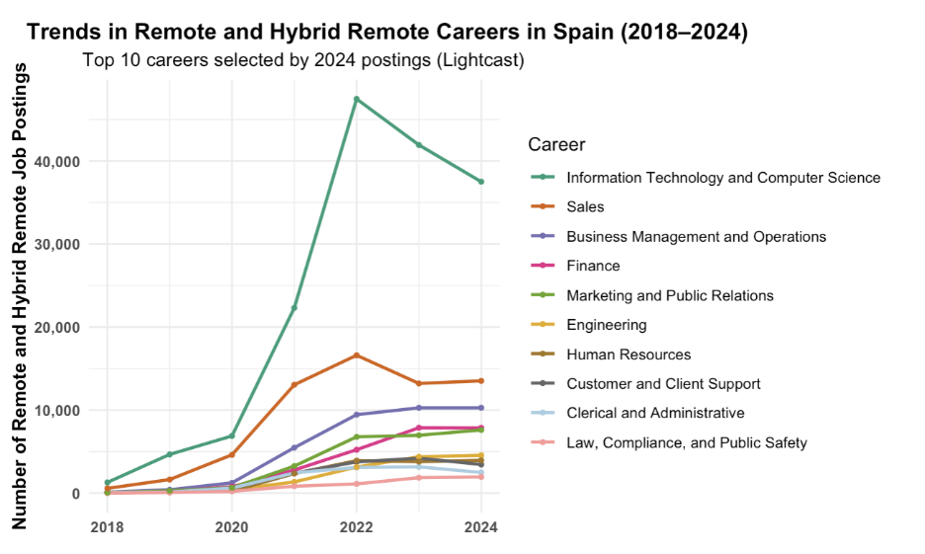
What are virtual occupations? (HIC Example, Spain)

Slide 8
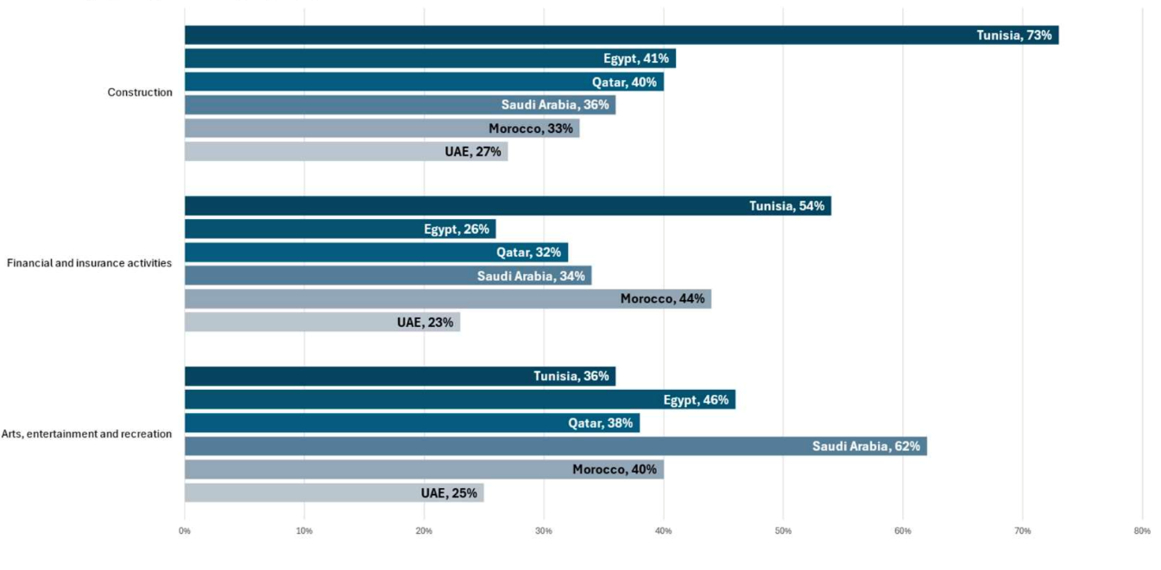
What are semi-virtual occupations?
Share of all job postings that are digital jobs, by sector
Source: World Bank (2025)

Slide 9
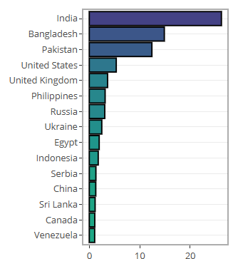
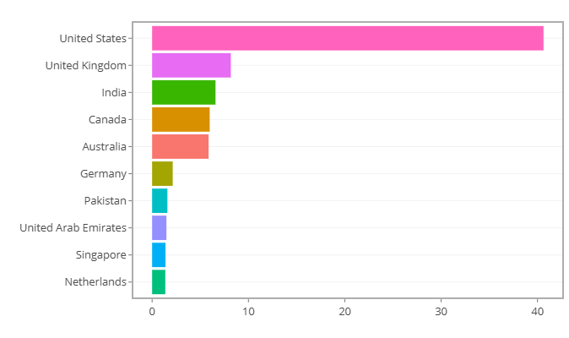
Where is it happening?
Demand Supply
Source: Online Labor Observatory: ILO and University of Oxford (2024)
Notes:
the highest demand for online work originates from the United States, followed by the United Kingdom, India, Canada, and Australia, while the largest supply comes from India, Bangladesh, and Pakistan

Slide 10
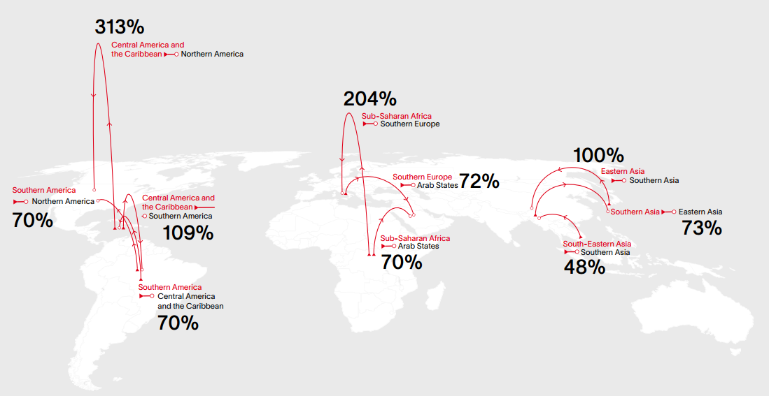
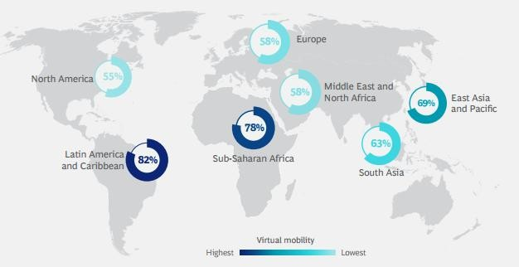
Where is it happening?
Firms in Higher-Paying Regions Are Hiring E Firms in Higher-Paying Regions Are Hiring Employees Living in Low-Cost Regions.
The largest interest in finding a VLM opportunity is observed among workers in sub-Saharan Africa and Latin America.
Interest in virtual mobility by region, 2023
Source: BCG (2025)
Region Pairs with Highest Increase in Remote Workers, 2020 to 2023
Source: Global Skills Marketplace (IFC, Revelio Labs and Lightcast 2023)
Notes:
Firms in Higher-Paying Regions Are Hiring E Firms in Higher-Paying Regions Are Hiring Employees Living in Low-Cost Regions employees Living in Low-Cost Regions Often, these pairs are aligned north to south; virtual migration is already happening!
North American companies with workers in Central America and the Caribbean (300% growth since January 2020);
Southern European companies with workers in Sub-Saharan Africa (200% growth since January 2020); and
Southern Asian companies with workers in Eastern Asia (100% growth since January 2020).

Slide 11
What are the determinants of VLM Viability?
Physical Presence Requirement: whether the job necessitates the worker's physical presence
Geographic and Temporal Proximity: Assessing if compatible time zones and common language are required.
Local Tech-Hub Necessity: Evaluating if a centralized tech-hub is needed.
Infrastructure Adequacy: Verifying necessary infrastructure, particularly reliable and high-speed internet access.
Technical Equipment Requirements: Identifying the specific technical equipment needed.
Cyber Security Concerns: Assessing potential cyber security risks and developing mitigation strategies.
Technologies facilitating virtual migration: Remote collaboration platforms, cloud computing, project management software, VR and AR.
Notes:
Factors influencing the feasibility of V-migration.

Slide 12

Paper Overview: Objective & Description
Development Objective: The report explores how technology can expand remote work opportunities that serve global markets (virtual migration), thereby reducing the reliance on physical migration*
Deep dives will focus on members of the Abu Dhabi Dialogue, as sending and receiving countries
Activity Description:
Define the concept of virtual migration and assess its relevance in today’s global labor market. (The What)
Analyze current global trends in remote work and the growing adoption of virtual migration, supported by data from labor platforms and research institutions (the Where and How)
Evaluate the potential of virtual migration to mitigate labor shortages in high-income countries and reduce unemployment in low- and middle-income countries.
Identify the legal, technological, social protection policies, and economic factors that can affect the implementation of virtual migration programs.
Develop a set of policy recommendations aimed at national governments, international organizations, and the private sector to support the scaling of VLM.
What policies and digital infrastructure improvements are needed to support expatriate workers who live within ADD member states but work remotely for companies abroad, ensuring their access to labor rights, taxation frameworks, and social protections?
How can ADD-based companies maximize the potential of hiring gig workers remotely within the region, reducing dependency on physical migration while addressing local skill shortages and labor demands?
*Recommendations will inform stakeholders (policy makers, DPs, Private sector, academics) on the viability of virtual migration as a tool for inclusive economic opportunities.

Slide 13
Methodology
Literature Review
Quantitative Survey
Existing reports, academic literature, and relevant datasets.
The Project aims to explore the persistence of remote work post-pandemic, its impact on various sectors and regions, and the necessary infrastructure and regulatory reforms to maximize its benefits.
The scope and focus of interviews and case studies will be determined based on the findings from the quantitative phase, specifically targeting areas where gaps or unexplored trends are identified.
The survey (fielded 3 times), includes a sample of 1,000-2,500 workers per country, over 34 countries, including China, India, Philippines, Thailand, and Vietnam.
Qualitative
This review will provide the background necessary to understand current trends, challenges, and opportunities in the areas of remote work and economic migration.
It will also help identify gaps in existing knowledge that the primary research phases aim to address.
These interviews will allow for a deeper understanding of the drivers and barriers to remote work and provide context for interpreting the quantitative data
Notes:
Argentina, Australia, Austria, Brazil, Canada, Chile, China, Czechia, Denmark, Egypt, Finland, France, Germany, Greece, Hungary, India, Ireland, Italy, Japan, Jordan, Korea, Malaysia, Mexico, Netherlands, New Zealand, Nigeria, Norway, Philippines, Poland, Portugal, Romania, Singapore, South Africa, Spain, Sweden, Taiwan, Thailand, Türkiye, UK, USA, Vietnam
The sp author team joined efforts and benefited from a research project by the Trade and International Integration Unit (DECTI) of the Development Research Group (DECRG), in partnership with the IFO Institute, in collaboration with the Macroeconomics, Trade, and Investment (MTI) Unit.

Slide 14
Outline
Overview
1. Virtual Labor Mobility as an Engine of Development in Home Countries
1.1. Defining Virtual Labor Mobility
1.2. The Value of Virtual Labor Mobility
2. Global Trends in Cross-border Remote Work
2.1. The rising demand for digital work
2.2. Cross-border Remote Work in Developing Countries
3. Pillars and Constraints of Virtual Labor Mobility
3.1. Infrastructure
3.2. Digital Skills
3.3. Regulatory Frameworks
4. Potential for Virtual Labor Mobility
4.1. Selected Countries
5. Role and Contribution of the World Bank
Conclusions

Slide 15
Thank you!

