Slide 1


Skills-based Labor Mobility as a Strategy for Climate Change Adaptation
The Gulf Cooperation Council (GCC) stands at a unique crossroads where climate resilience meets labor market transformation. As demand for sustainable solutions intensifies across the region, Skills Mobility Partnerships emerge as a powerful strategy to bridge critical workforce gaps while advancing climate adaptation goals.
Prepared for: International Organization for Migration (IOM) Abu Dhabi Dialogue
By Henry Gordon-Smith, CEO, Agritecture

Slide 2


The Climate-Skills Nexus: A Regional Challenge
Climate Pressures Intensifying
Food insecurity deepening across GCC states
Water stress reaching critical thresholds
Waste generation accelerating with urbanization
Billions invested in green infrastructure solutions
Without skilled technicians to operate these systems, multi-billion dollar investments in controlled environment agriculture and circular waste systems risk underperforming—jeopardizing broader green transition targets across the region.
Critical Gap: Technology and capital are outpacing the supply of skilled technicians and supervisors needed to operate climate-smart infrastructure effectively.

Slide 3
8 Essential Elements of Skills Mobility Partnerships (SMPs)

Slide 4



Why SMPs Matter Now: Three Converging Dynamics
Countries of Origin Have People, Not Pathways
Egypt and India possess surplus graduates but lack workers skilled in modern green sectors. Existing agricultural education systems aren't calibrated to GCC's controlled-environment agriculture and waste management needs.
GCC Scaling Climate-Smart Sectors
UAE aims for 50,000 green jobs by 2030. Saudi Vision 2030 centers food security and waste-to-energy. Qatar, Oman, Kuwait pursuing similar strategies—all dependent on trained workforce availability.
Evidence of Widening Skills Gap
UAE faces significant shortage for climate-smart farms. Many large-scale operations remain dependent on short-term expatriate consultants rather than sustainable labor pipeline.

Slide 5
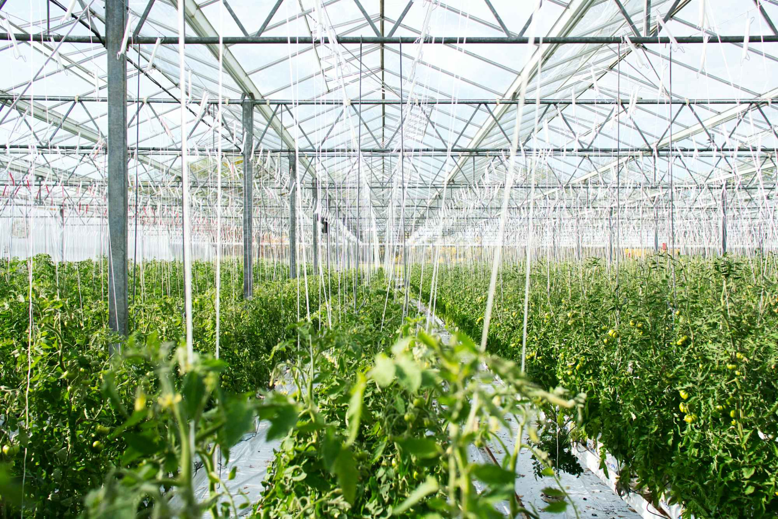

Case Study 1: Controlled Environment Agriculture
What is CEA?
Controlled Environment Agriculture uses technology to optimize climate conditions for crop growth through:
Hydroponics systems
Vertical farming
Climate-controlled greenhouses
CEA uses up to 90% less water than conventional farming while enabling year-round production—essential for arid regions.
Major GCC investments include UAE's Bustanica ($40M vertical farm), Pure Harvest Smart Farms ($180.5M raised), and Saudi Arabia's commitment to scale greenhouse cultivation by thousands of hectares by 2030.

Slide 6

The CEA Skills Gap: Quantifying the Challenge
92%
75%
Operators
Premium Pay
Reported interest in hiring additional skilled labor
Would pay 11-25% more for certified workers
1,700
$40M
Roles Needed
Annual Cost
Certified positions required by 2030
Opportunity cost of skills shortage
Critical Skills Required
Operating and maintaining irrigation and fertigation systems
Managing climate control technologies, sensors, and AI-based monitoring
Implementing integrated pest management in closed systems
Overseeing food safety, quality assurance, and traceability standards
Notes:
Current inefficiencies include USD 2,000+ per technician training costs, 20-25% turnover rates, and consultant dependencies adding USD 3M annually. Conservative 5% productivity loss equals USD 35M yearly based on sector's USD 700M market size.

Slide 7
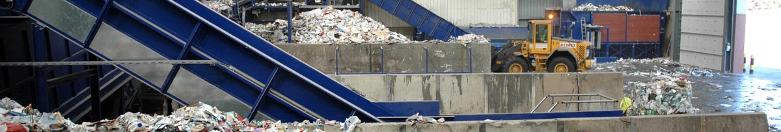
Case Study 2: Waste Management Revolution
262.7M
192M
50%
75%
Tons Collected
Tons Treated
CDW Portion
Regional Share
Total waste in GCC by 2023, marking 153.7% increase since 2019
Waste processed, reflecting 128.5% increase in treatment capacity
Construction and demolition waste constitutes over half of GCC waste production
Saudi Arabia and UAE account for three-quarters of total waste generated
Flagship projects include Sharjah's BEEAH WtE plant (first commercial-scale in Middle East) and Dubai's Waste-to-Energy Centre (converting 5,666 tons MSW daily into electricity). The transformation requires skilled technicians across collection, treatment, recycling, and waste-to-energy operations.

Slide 8
Building the Green Skills Pipeline: Joint SMP Framework
Strategic Planning & Assessment
1
GCC employers identify specific shortages (CEA climate-control operators, WtE technicians). CoOs assess worker availability and domestic demand to ensure training creates value both locally and in GCC markets.
2
Evidence-Based Training Design
Technical colleges in Egypt and ICAR centers in India adapt curricula to GCC requirements. Vendor-certified modules embedded with hands-on learning at practical training farms and waste innovation labs.
Governance & Recognition
3
Co-design with employers, institutions, and ministries. Portable "Green Technician" framework co-developed with IOM, ensuring credential portability and job-readiness across borders.
4
Ethical Mobility & Benefits
IRIS-standard ethical recruitment with zero worker fees. Training strengthens CoO labor markets; returnees connect to agritech incubators and circular enterprises for local impact.

Slide 9

Policy Roadmap
1
Strengthen Skills Development and Recognition
2
Design Predictable Labor Mobility Pathways
Mandate joint curricula between GCC employers and CoO institutions. Establish mutual recognition framework for "Green Technician" credentials. Fund Training-of-Trainers programs for independent, scalable delivery.
Pilot mobility schemes between Egypt, India, and GCC facilities with IRIS ethical recruitment standards. Integrate SMPs into bilateral agreements covering visas, contracts, and worker protections.
3
Promote Public-Private Partnerships
4
Establish Robust Governance Standards
Establish sector consortia to co-finance training hubs. Partner with development banks and UN agencies for blended financing models ensuring zero worker-paid fees.
Institutionalize 30-40% female participation targets. Require evidence-based monitoring tracking placement, retention, and productivity data.

Slide 10
Triple Dividends: A Climate-Smart Future
For GCC States
For Origin Countries
For Migrant Workers
Reliable pipeline of skilled workers to realize national food security and circular economy goals, reducing dependence on consultants while maximizing green infrastructure returns.
Enhanced workforce productivity and international competitiveness. Ability to attract FDI through skilled workforce availability. Meaningful reintegration opportunities strengthening home resilience.
Decent formal economy jobs at home and safe, dignified mobility pathways abroad with career advancement prospects and portable skills certification.
By launching the first climate-focused SMPs in CEA and waste management by 2026, ADD states can set a global precedent—proving that migration, skills, and climate action are not competing agendas, but converging solutions for a resilient future.

