Slide 1

The Arab Region and the GCM: Achievements, Priorities, and the Road to 2026

Slide 2

About the Global Compact for Safe, Orderly & Regular Migration (GCM)
What is the GCM?
Non-legally binding, cooperative framework adopted in 2018
Promote safe, orderly, and regular migration through international cooperation
Holistic and comprehensive approach to addressing international migration
Key Objectives
23 Objectives
Principles of sovereignty, human rights, and sustainable development
IOM's Role
Facilitates dialogue, and coordinates efforts among member states
Coordinator and the Secretariat of the UN Network on Migration (UNNM)

Slide 3
About the United National Network on Migration (UNNM)
The UNNM in MENA (Middle East and North Africa), led by IOM and UN ESCWA, facilitates GCM implementation in the region and via national networks.
Global Network
Regional Networks
Partnership Building: Strengthens collaboration among regional bodies, governments, and civil society.
National Networks
Stakeholder Engagement: Promotes inclusive dialogue among ministries, civil society, and migrants.
Coordination & Guidance: Provide strategic direction and coherence across UN entities.
Support to IMRF: Leads preparations for the IMRF.
Contextualisation of the GCM: Adapts global priorities to regional migration dynamics and challenges.
Regional Reviews: Coordinate inputs from member states and UN agencies.
Implementation Support: Assists governments in translating GCM objectives into national policies and action plans.
Capacity Building: Organizes workshops, consultations, and technical support.
Knowledge Sharing: Facilitates global exchange of good practices, data, and policy innovations.

Slide 4
GCM National Voluntary Reviews (GCMRs) in the Arab World
GCMR
Country-led review of progress in implementing the GCM.
Helps governments assess achievements, challenges, and future priorities, and contributes to the global dialogue at the IMRF.
Since 2022, multiple countries in the Arab Region conducted GCMRs: Egypt, Tunisia, United Arab Emirates (UAE).
Examples of GCM Pledges by MENA Region Countries
Country | Pledges Submitted Year | Description
Egypt | 2022 | Submitted by Regional UNNM for Arab States Offers material support for 2024 GCM reviews
Morocco | 2025 | Rooted in ASTICUDE/ACPP’s migration research & UCLG experiences Trains 40+ narrative creators
Lebanon | 2022 | Mobile health clinic for migrants, refugees, and vulnerable locals

Slide 5
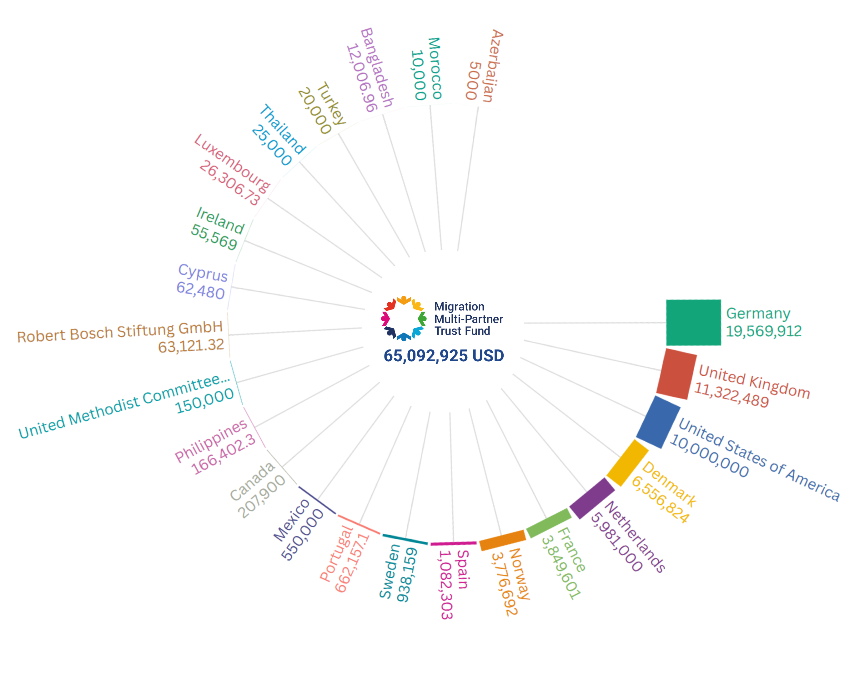
Migration Multi-Partner Trust Fund (MMPTF)
Migration Multi-Partner Trust Fund (MMPTF)
Funding instrument in the field of migration.
Launched in July 2019
Financed twenty-seven programmes.
For Arab countries:
Project 1 – Iraq, Jordan, Lebanon
Joint Program: IOM, UNDRR, WHO.
Theme: Climate Change & Disaster Risk Reduction
Goal: Address migration drivers like climate stress & health risks
Funding: USD 3.2 million
Project 2 – Morocco
Joint Program: IOM, UNFPA, UNHCR, UNICEF
Theme: Social Inclusion & Access to Services
Focus: Support for women, children, and vulnerable migrants in accessing basic services
Funding: USD 2 million

Slide 6
How to Engage?
Conduct consultative national voluntary GCM reviews with stakeholder input.
Include migrants and local governments in delegations to the IMRF.
Make voluntary GCM pledges ahead of the IMRF through a simple submission form.
Participate in the GCM Champions Initiative: The UNNM invited a group of Member States to serve as “Champion countries” for the implementation of the Global Compact for Migration, targeting them with explicit support from the Network, while also generating key insights, lessons learned, and positive practices that can be shared in dedicated spaces and with other Member States.
Contribute to the GCM’s Capacity Building Mechanism’s Migration Multi-Partner Trust Fund.
Attend the IMRF at high-level and include stakeholders and local government representatives in IMRF delegations.
For any further information email:
snonnenmache@iom.int

